Slide 1
1

Slide 2
Will Mortgage Rates
Keep Rising?
2

Slide 3
Mortgage Rates Rising This Year
Freddie Mac 30-Year Fixed Rate, January 2022–Today
6.95
3.22
Source: Freddie Mac
3
Notes:
https://freddiemac.gcs-web.com/node/26191/pdf
http://www.freddiemac.com/pmms/

Slide 4
U.S. 30-year fixed mortgage rates have increased 3.83 percentage points since the end of last year. That's the biggest year-to-date increase in rates in over 50 years.
- Len Kiefer, Deputy Chief Economist, Freddie Mac
4
Notes:
https://twitter.com/lenkiefer/status/1583120440477638656

Slide 5
With inflation still running at a 40-year high and the Fed expecting a few more rate increases to combat it, mortgage rates will experience upward pressure through the end of 2022.
- George Ratiu, Manager of Economic Research, Realtor.com
5
Notes:
https://twitter.com/GeorgeRatiu/status/1588171575613804544

Slide 6
While mortgage rates are expected to continue to drift higher over the coming months, much of the rapid increase in rates is likely behind us.
- Mark Fleming, Chief Economist, First American
6
Notes:
https://www.firstam.com/news/2022/overvalued-markets-increasing-20220927.html

Slide 7
Is a Recession Around the Corner?
WSJ Economists’ Survey: Chances of a Recession in the Next 12 Months
Source: WSJ
7
Notes:
https://www.wsj.com/articles/economic-forecasting-survey-archive-11617814998

Slide 8
A Recession Does Not Mean Falling Prices
Home Price Change During Last 6 Recessions
1991
2008
Sources: CoreLogic, The Balance
8
Notes:
https://www.corelogic.com/blog/2019/03/housing-recessions-and-recoveries.aspx​
https://www.thebalance.com/the-history-of-recessions-in-the-united-states-3306011​
https://www.corelogic.com/intelligence/find-stories/corelogic-hpi-posted-record-year-over-year-growth-in-2021/​

Slide 9
A Recession Means Falling Mortgage Rates
Mortgage Rate Changes During the Last 6 Recessions
Source: Freddie Mac, The Balance
9
Notes:
http://www.freddiemac.com/pmms/
https://mtg-specialists.com/2022/05/11/recession-interest-rates-and-real-estate/

Slide 10
What Are Experts Saying
About Home Prices?
10

Slide 11
For those bearish folks eagerly awaiting the home price crash, you'll have to keep waiting. As much as demand is pulling back supply is as well reducing downward pressure on prices in the short run.
- Taylor Marr, Deputy Chief Economist, Redfin
11
Notes:
https://twitter.com/tayloramarr/status/1578082283281596418

Slide 12
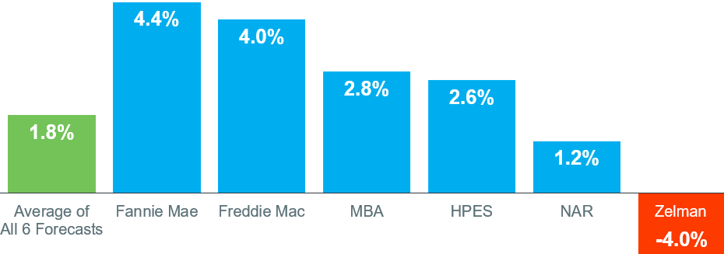
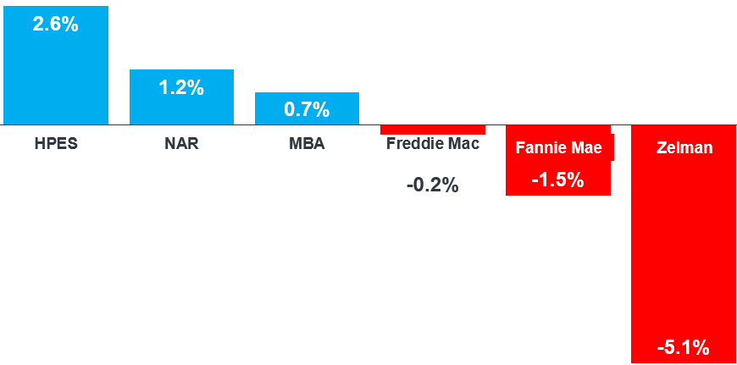
Home Price Forecasts for 2023
Latest Forecasts from Each Entity
12
Notes:
https://www.fanniemae.com/media/44911/display
https://pulsenomics.com/surveys/#home-price-expectations
https://www.freddiemac.com/research/forecast/20221021-quarterly-forecast-rapidly-rising-rates-declining-demand-driving-housing-market
https://www.mba.org/docs/default-source/research-and-forecasts/forecasts/mortgage-finance-forecast-oct-2022.pdf?sfvrsn=d32917_1
https://cdn.nar.realtor/sites/default/files/documents/forecast-q4-2022-us-economic-outlook-09-28-2022.pdf
https://www.zelmanassociates.com/ (by subscription)

Slide 13
Home Prices Forecast To Fall in 2023
Big Banks Calling for Home Prices To Depreciate Next Year
13
Notes:
https://www.morganstanley.com/ideas/thoughts-on-the-market-us-housing
https://wellsfargo.bluematrix.com/links2/html/429eb828-b17e-4e47-8856-4ff59f9d3d1a
https://www.goldmansachs.com/insights/pages/why-home-prices-are-poised-to-fall.html
https://cre.moodysanalytics.com/insights/research/housing-sector-in-the-second-quarter/

Slide 14
Home Prices To Fall, and Then Recover
Wells Fargo Home Price Forecasts for 2023 and 2024
2024
14
Notes:
https://wellsfargo.bluematrix.com/links2/html/429eb828-b17e-4e47-8856-4ff59f9d3d1a

Slide 15
While there might be little statistical difference between a small positive number and a small negative number, there are often huge differences in how they may impact behavior.
- Len Kiefer, Deputy Chief Economist, Freddie Mac
15
Notes:
https://twitter.com/lenkiefer/status/1580322701402525697

Slide 16
GFC: Home Prices Depreciated for 5 Years
Home Price Appreciation 2006-2013
2007
2008
2009
2010
Source: Zelman & Associates
16
Notes:
www.zelmanandassociates.com (subscription required)

Slide 17
What About Foreclosures?
17

Slide 18
Foreclosure Activity by Year
U.S. Properties with Foreclosure Filings: ATTOM 2021 Year-End Report
Over 1 Million
Source: ATTOM Data Solutions
18
Notes:
https://www.attomdata.com/news/market-trends/foreclosures/attom-year-end-2021-u-s-foreclosure-market-report/
165 first half of 2022 roughly the same as 2020

Slide 19
.4%
Only about 214,800 homeowners were facing possible foreclosure in the second quarter of 2022, or just four-tenths of one percent of the 58.2 million outstanding mortgages in the U.S. Of those facing foreclosure, about 195,400, or 91 percent, had at least some equity built up in their homes.
- ATTOM Data
19
Notes:
https://www.attomdata.com/news/market-trends/home-sales-prices/attom-q2-2022-u-s-home-equity-and-underwater-report/

Slide 20
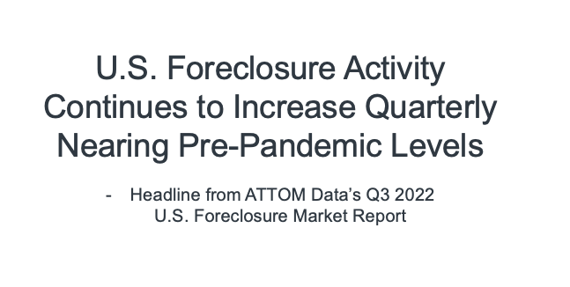
Anyone waiting for a huge foreclosure wave will probably be disappointed by this report from ATTOM Data - foreclosure activity was flat Q1 to Q2, and foreclosure starts dropped slightly from August to September.
- Rick Sharga, EVP, ATTOM
20
Notes:
https://twitter.com/ricksharga/status/1580617436617142272

Slide 21
Housing Supply Is Still Historically Low
Inventory the Week Ending October 28th Compared to Last 3 Years
Source: Calculated Risk
21
Notes:
https://www.calculatedriskblog.com/2022/10/housing-october-31st-weekly-update.html

Slide 22
Should I Buy a Home
Right Now?
22

Slide 23
Median Asking Rent Since 1988
Source: Census
23
Notes:
http://www.census.gov/housing/hvs/files/currenthvspress.pdf
Table 11A. Median Asking Rent for the U.S. and Regions: 1988 to Present

Slide 24
If you can find a house that meets your financial expectations for a monthly payment and it is a good time for you to buy, then do that, . . . And if you wait for prices to fall but they never do, you may discover the hard way that the house that you found a year ago that you really loved, that you could afford but you passed up on, is more expensive next year.
- Odeta Kushi, Deputy Chief Economist, First American
24
Notes:
https://www.syracuse.com/business/2022/09/home-prices-might-drop-but-wont-crash-what-buyers-should-know.html

Slide 25
In the absence of trustworthy, up-to-date information, real estate decisions are increasingly being driven by fear, uncertainty, and doubt. These decisions can be hugely consequential for consumers and businesses.
- Jason Lewris, Co-Founder & Chief Data Officer, Parcl
25
Notes:
https://www.parcllabs.com/articles/q3-real-estate

Slide 26
Updates
26

Slide 27
Average Days on the Market
September 2022
Source: NAR
27
Notes:
https://www.nar.realtor/research-and-statistics/research-reports/realtors-confidence-index
https://cdn.nar.realtor/sites/default/files/documents/2022-08-realtors-confidence-index-09-21-2022.pdf

Slide 28
Existing Home Sales
Since January 2014
Source: NAR
28
Notes:
https://www.nar.realtor/topics/existing-home-sales
https://www.nar.realtor/newsroom/existing-home-sales-decreased-1-5-in-september

Slide 29
Existing Home Sales
Year-Over-Year, by Region
Source: NAR
29
Notes:
https://www.nar.realtor/topics/existing-home-sales
https://www.nar.realtor/newsroom/existing-home-sales-decreased-1-5-in-september

Slide 30
Existing Home Sales
In Thousands
Source: NAR
30
Notes:
https://www.nar.realtor/topics/existing-home-sales
https://cdn.nar.realtor/sites/default/files/documents/ehs-09-2022-overview-2022-10-20.pdf

Slide 31
New Home Sales
In Thousands
Source: Census
31
Notes:
http://www.census.gov/construction/nrs/pdf/newressales.pdf

Slide 32
Total Home Sales
In Thousands
Source: Census
32
Notes:
http://www.census.gov/construction/nrs/pdf/newressales.pdf
https://www.nar.realtor/topics/existing-home-sales
https://cdn.nar.realtor/sites/default/files/documents/ehs-09-2022-overview-2022-10-20.pdf

Slide 33
Pending Home Sales
Year-Over-Year by Region
100 = Historically Healthy Level
Source: NAR
33
Notes:
https://www.nar.realtor/research-and-statistics/housing-statistics/pending-home-sales
https://cdn.nar.realtor/sites/default/files/documents/phs-09-2022-pending-home-sales-10-28-2022.pdf

Slide 34
Percentage of Distressed Property Sales
Distressed Sales (Foreclosures and Short Sales) represented 2% of Sales in September.
4%
Source: NAR
34
Notes:
https://www.nar.realtor/topics/existing-home-sales
https://www.nar.realtor/newsroom/existing-home-sales-decreased-1-5-in-september

Slide 35
Home Prices
35

Slide 36
Sales Price of Existing Homes
Year-Over-Year, by Region
Source: NAR
36
Notes:
https://www.nar.realtor/topics/existing-home-sales
https://www.nar.realtor/newsroom/existing-home-sales-decreased-1-5-in-september

Slide 37
Housing Inventory
37

Slide 38
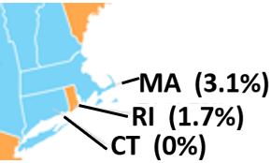
Change in Inventory
Month-Over-Month, October 2022
Source: realtor.com
38
Notes:
https://www.realtor.com/research/data/

Slide 39
Months Inventory of Homes for Sale
2011 - Today
Source: NAR
39
Notes:
https://www.nar.realtor/topics/existing-home-sales
https://www.nar.realtor/newsroom/existing-home-sales-decreased-1-5-in-september

Slide 40
Months Inventory of Homes for Sale
Since 2019
4.6
4.3
3.2
Source: NAR
40
Notes:
https://www.nar.realtor/topics/existing-home-sales
https://www.nar.realtor/newsroom/existing-home-sales-decreased-1-5-in-september

Slide 41
Months Inventory of Homes for Sale
Last 12 Months
Source: NAR
41
Notes:
https://www.nar.realtor/topics/existing-home-sales
https://www.nar.realtor/newsroom/existing-home-sales-decreased-1-5-in-september

Slide 42
Year-Over-Year Inventory Levels
Last 12 Months
Sept
June
July
Aug
42
Source: NAR
Notes:
https://www.nar.realtor/topics/existing-home-sales
https://www.nar.realtor/newsroom/existing-home-sales-decreased-1-5-in-september

Slide 43
Buyer Demand
43

Slide 44
Traffic Continues To Decline While Remaining Above Pre-Pandemic Levels
Year-Over-Year Increase in Showing Activity, September 2022
Michael Lane, Vice President & General Manager, ShowingTime
“In addition to the regular seasonal slowdown we would expect, buyers who can’t overcome affordability challenges are opting out of the market and contributing to the fewer showings we saw in September.”
Source: ShowingTime
44
Notes:
https://www.showingtime.com/blog/september-2022-showing-index-results/

Slide 45
45

Slide 46
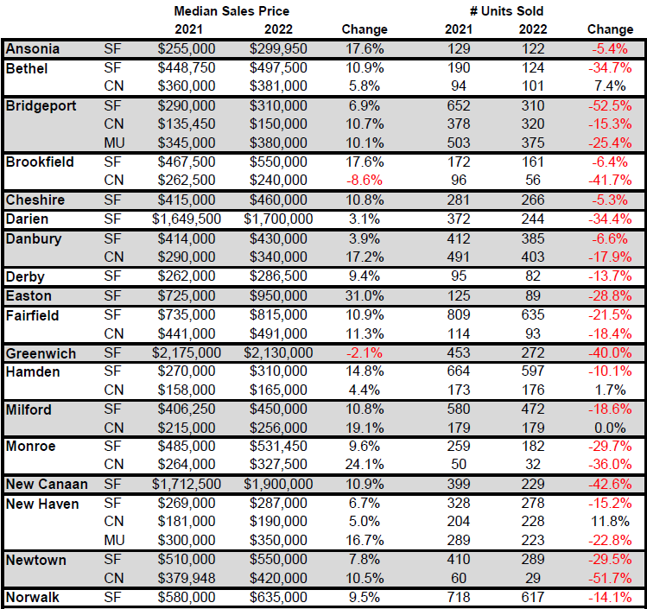
46

Slide 47
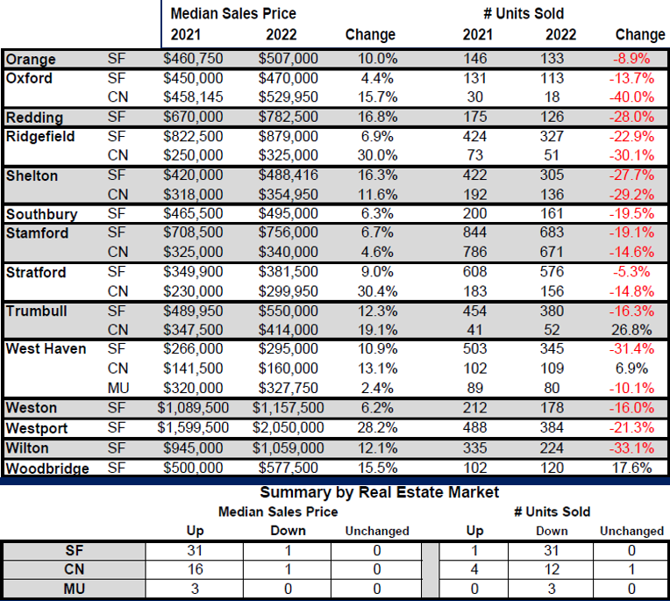
47

Slide 48
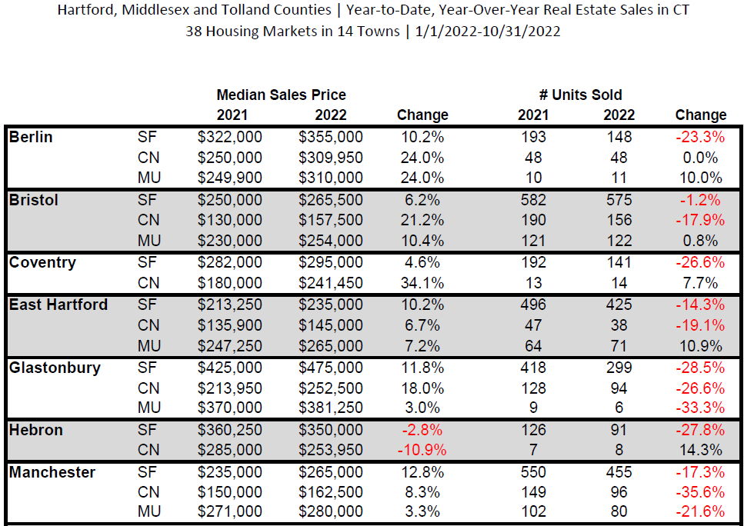
48

Slide 49
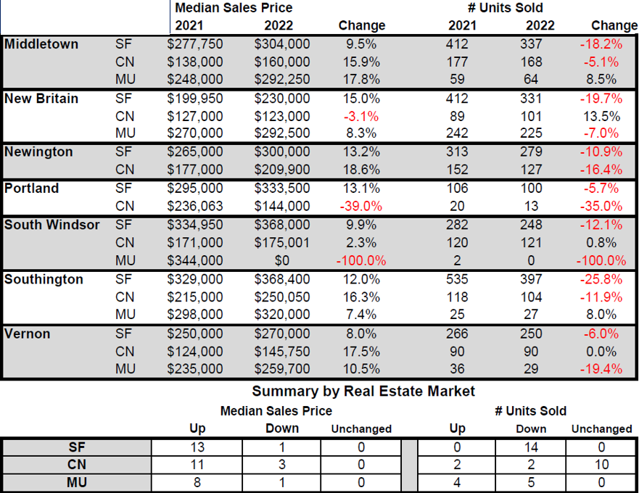
49

Slide 50
TOWN STATS
Single Family
Transactions in 46 towns
1 Up
45 Down
0 Unchanged
50

Slide 51
TOWN STATS
Single Family
Median Sales Price in 44 towns
44 Up
2 Down
0 Unchanged
51

Slide 52
 | Fairfield County |  |  | New Haven County |  |  | Hartford County
SINGLE FAMILY | January 1 – October 31 |  |  | January 1 – October 31 |  |  | January 1 – October 31
Key Metrics | Thru 10-2021 | Thru 10-2022 | % Change | Thru 10-2021 | Thru 10-2022 | % Change | Thru 10-2021 | Thru 10-2022 | % Change
New Listings | 11,336 | 9,050 | -20.0% | 9,079 | 7,798 | -14.1% | 9,870 | 8,127 | -17.7%
Pending Sales | 9,213 | 7,127 | -22.6% | 7,600 | 6,381 | -16.0% | 8,431 | 6,981 | -17.2%
Closed Sales | 9,179 | 7,192 | -21.6% | 7,499 | 6,352 | -15.3% | 8,161 | 6,920 | -15.2%
Median Sales Price | $620,000 | $650,000 | +4.8% | $300,000 | $339,500 | +13.2% | $290,000 | $316,000 | +9.0%
Percent of List Price Received | 101.1% | 103.0% | +1.9% | 101.9% | 102.6% | +0.7% | 103.0% | 104.4% | +1.4%
 | Fairfield County |  |  | New Haven County |  |  | Hartford County
TOWNHOUSE/CONDO | January 1 – October 31 |  |  | January 1 – October 31 |  |  | January 1 – October 31
Key Metrics | Thru 10-2021 | Thru 10-2022 | % Change | Thru 10-2021 | Thru 10-2022 | % Change | Thru 10-2021 | Thru 10-2022 | % Change
New Listings | 3,928 | 3,156 | %-19.7 | 2,753 | 2,353 | -14.5% | 2,723 | 2,153 | -20.9%
Pending Sales | 3,353 | 2,683 | -20.0% | 2,382 | 2,079 | -12.7% | 2,440 | 2,003 | -17.9%
Closed Sales | 3,312 | 2,699 | -18.5% | 2,349 | 2,103 | -10.5% | 2,365 | 2,002 | -15.3%
Median Sales Price | $300,000 | $335,000 | +11.7% | $180,000 | $200,000 | +11.1% | $180,000 | $205,000 | +13.9%
Percent of List Price Received | 99.5% | 101.5% | +2.0% | 100.3% | 101.8% | +1.5% | 100.9% | 103.4% | +2.5%
52

Slide 53
Fairfield County |  |  | New Haven County |  |  | Hartford County
January 1 – January 31 |  |  | January 1 – January 31 |  |  | January 1 – January 31
Thru 1-2021 | Thru 1-2022 | % Change | Thru 1-2021 | Thru 1-2022 | % Change | Thru 1-2021 | Thru 1-2022 | % Change
772 | 525 | -32.00% | 548 | 490 | -10.60% | 601 | 475 | -21.00%
January 1 – April 30 |  |  | January 1 – April 30 |  |  | January 1 – April 30
Thru 4 -2021 | Thru 4 -2022 | % Change | Thru 4 -2021 | Thru 4 -2022 | % Change | Thru 4-2021 | Thru 4 -2022 | % Change
4,336 | 3,312 | -23.60% | 3,156 | 2,832 | -10.30% | 3,406 | 2,920 | -14.30%
Single Family – New Listings
January 1 – July 31 |  |  | January 1 – July 31 |  |  | January 1 – July 31
Thru 7-2021 | Thru 7-2022 | % Change | Thru 7-2021 | Thru 7-2022 | % Change | Thru 7-2021 | Thru 7-2022 | % Change
8,506 | 6,829 | -19.70% | 6,459 | 5,665 | -12.30% | 7,009 | 5,925 | -15.50%
January 1 – October 31 |  |  | January 1 – October 31 |  |  | January 1 – October 31
Thru 10 -2021 | Thru 10 -2022 | % Change | Thru 10 -2021 | Thru 10 -2022 | % Change | Thru 10 -2021 | Thru 10 -2022 | % Change
11,336 | 9,050 | -20.00% | 9,079 | 7,798 | -14.10% | 9,870 | 8,127 | -17.70%
53

Slide 54
Fairfield County |  |  | New Haven County |  |  | Hartford County
January 1 – January 31 |  |  | January 1 – January 31 |  |  | January 1 – January 31
Thru 1-2021 | Thru 1-2022 | % Change | Thru 1- 2021 | Thru 1-2022 | % Change | Thru 1- 2021 | Thru 1-2022 | % Change
729 | 556 | -23.70% | 620 | 589 | 5.00% | 585 | 600 | 2.60%
January 1 – April 30 |  |  | January 1 – April 30 |  |  | January 1 – April 30
Thru 4 -2021 | Thru 4 -2022 | % Change | Thru 4 - 2021 | Thru 4 -2022 | % Change | Thru 4 - 2021 | Thru 4 -2022 | % Change
3,275 | 2,677 | -18.30% | 2,681 | 2,425 | -9.50% | 2,761 | 2,582 | -6.50%
Single Family – Pending Sales
January 1 – July 31 |  |  | January 1 – July 31 |  |  | January 1 – July 31
Thru 7-2021 | Thru 7-2022 | % Change | Thru 7- 2021 | Thru 7-2022 | % Change | Thru 7- 2021 | Thru 7-2022 | % Change
6,538 | 5,139 | -21.40% | 5,318 | 4,575 | -14.00% | 5,824 | 4,936 | -15.20%
January 1 – October 31 |  |  | January 1 – October 31 |  |  | January 1 – October 31
Thru 10 -2021 | Thru 10 -2022 | % Change | Thru 10 -2021 | Thru 10 -2022 | % Change | Thru 10 -2021 | Thru 10 -2022 | % Change
9,213 | 7,127 | -22.60% | 7,600 | 6,381 | -16.00% | 8,431 | 6,981 | -17.20%
54

Slide 55
Fairfield County |  |  | New Haven County |  |  | Hartford County
January 1 – January 31 |  |  | January 1 – January 31 |  |  | January 1 – January 31
Thru 1-2021 | Thru 1-2022 | % Change | Thru 1-2021 | Thru 1-2022 | % Change | Thru 1-2021 | Thru 1-2022 | % Change
750 | 603 | -19.60% | 636 | 547 | 14.00% | 589 | 603 | 2.40%
January 1 – April 30 |  |  | January 1 – April 30 |  |  | January 1 – April 30
Thru 4 -2021 | Thru 4 -2022 | % Change | Thru 4 - 2021 | Thru 4 -2022 | % Change | Thru 4 -2021 | Thru 4 -2022 | % Change
2,975 | 2,331 | -21.60% | 2,495 | 2,112 | -15.40% | 2,493 | 2,262 | -9.30%
Single Family – Closed Sales
January 1 – July 31 |  |  | January 1 – July 31 |  |  | January 1 – July 31
Thru 7-2021 | Thru 7-2022 | % Change | Thru 7- 2021 | Thru 7-2022 | % Change | Thru 7-2021 | Thru 7-2022 | % Change
6,271 | 4,892 | -22.00% | 5,039 | 4,325 | -14.20% | 5,430 | 4,694 | -13.60%
January 1 – October 31 |  |  | January 1 – October 31 |  |  | January 1 – October 31
Thru 10 -2021 | Thru 10 -2022 | % Change | Thru 10 -2021 | Thru 10 -2022 | % Change | Thru 10 -2021 | Thru 10 -2022 | % Change
9,179 | 7,192 | -21.60% | 7,499 | 6,352 | -15.30% | 8,161 | 6,920 | -15.20%
55

Slide 56
Fairfield County |  |  | New Haven County |  |  | Hartford County
January 1 – January 31 |  |  | January 1 – January 31 |  |  | January 1 – January 31
Thru 1-2021 | Thru 1-2022 | % Change | Thru 1-2021 | Thru 1-2022 | % Change | Thru 1-2021 | Thru 1-2022 | % Change
$548,549 | $550,000 | 0.30% | $269,900 | $299,000 | 10.80% | $268,900 | $275,000 | 2.30%
January 1 – April 30 |  |  | January 1 – April 30 |  |  | January 1 – April 30
Thru 4 -2021 | Thru 4 -2022 | % Change | Thru 4 -2021 | Thru 4 -2022 | % Change | Thru 4-2021 | Thru 4 -2022 | % Change
$575,000 | $599,000 | 4.20% | $279,900 | $311,000 | 11.10% | $270,000 | $290,000 | 7.40%
Single Family – Median Sales Price
January 1 – July 31 |  |  | January 1 – July 31 |  |  | January 1 – July 31
Thru 7-2021 | Thru 7-2022 | % Change | Thru 7-2021 | Thru 7-2022 | % Change | Thru 7-2021 | Thru 7-2022 | % Change
$630,000 | $650,000 | 3.20% | $299,900 | $332,000 | 10.70% | $285,500 | $315,000 | 10.30%
January 1 – October 31 |  |  | January 1 – October 31 |  |  | January 1 – October 31
Thru 10 -2021 | Thru 10 -2022 | % Change | Thru 10 -2021 | Thru 10 -2022 | % Change | Thru 10 -2021 | Thru 10 -2022 | % Change
$620,000 | $650,000 | 4.80% | $300,000 | $339,500 | 13.20% | $290,000 | $316,000 | 9.00%
56

Slide 57
Fairfield County |  |  | New Haven County |  |  | Hartford County
January 1 – January 31 |  |  | January 1 – January 31 |  |  | January 1 – January 31
Thru 1-2021 | Thru 1-2022 | % Change | Thru 1-2021 | Thru 1-2022 | % Change | Thru 1- 2021 | Thru 1-2022 | % Change
98.80% | 101.20% | 2.40% | 98.00% | 101.10% | 1.00% | 100.60% | 101.80% | 1.20%
Single Family – % of List Price Received
January 1 – April 30 |  |  | January 1 – April 30 |  |  | January 1 – April 30
Thru 4 -2021 | Thru 4 -2022 | % Change | Thru 4 -2021 | Thru 4 -2022 | % Change | Thru 4 - 2021 | Thru 4 -2022 | % Change
99.90% | 102.30% | 2.40% | 100.50% | 102.00% | 1.50% | 101.50% | 103.90% | 2.40%
January 1 – July 31 |  |  | January 1 – July 31 |  |  | January 1 – July 31
Thru 7-2021 | Thru 7-2022 | % Change | Thru 7-2021 | Thru 7-2022 | % Change | Thru 7- 2021 | Thru 7-2022 | % Change
101.20% | 103.70% | 2.50% | 101.90% | 103.20% | 1.30% | 103.10% | 105.10% | 1.90%
January 1 – October 31 |  |  | January 1 – October 31 |  |  | January 1 – October 31
Thru 10 -2021 | Thru 10 -2022 | % Change | Thru 10 -2021 | Thru 10 -2022 | % Change | Thru 10 -2021 | Thru 10 -2022 | % Change
101.10% | 103.00% | 1.90% | 101.90% | 102.60% | 0.70% | 103.00% | 104.40% | 1.40%
57

Slide 58
You don’t have to be great to start,
but you have to start to be great.
~ Joe Sabah
58

Slide 60
Real Estate Success Formula for 2023

Slide 61
Trusted Advisor / Strategist
Notes:
Correct the spacing. Trusted Advisor / Strategist

Slide 62
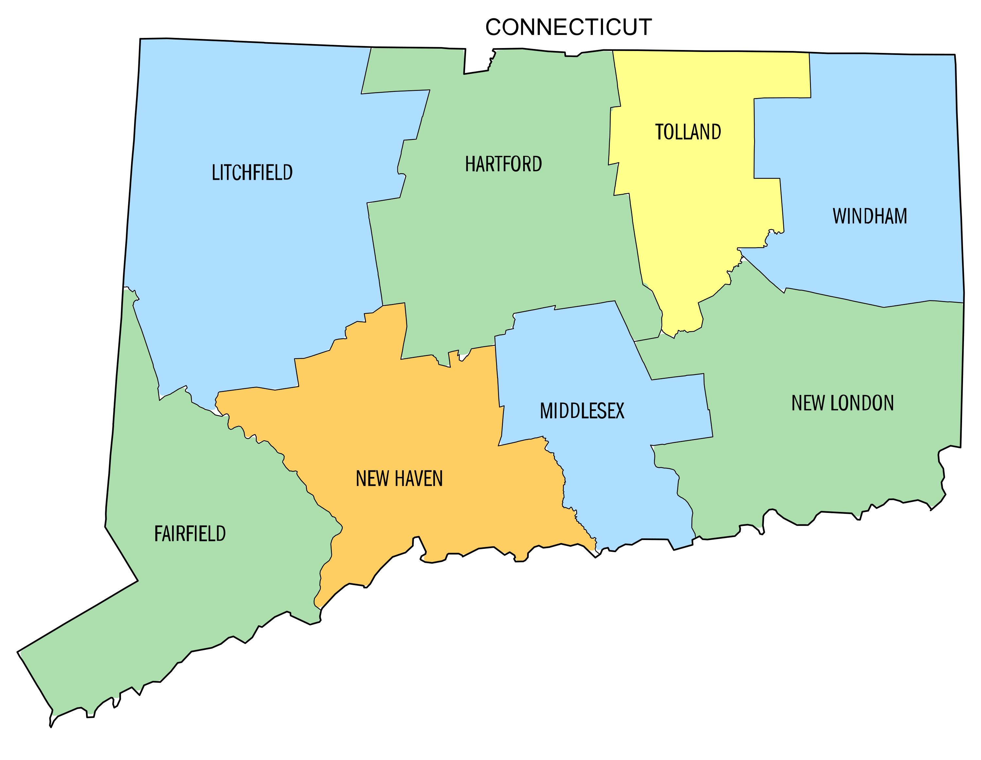
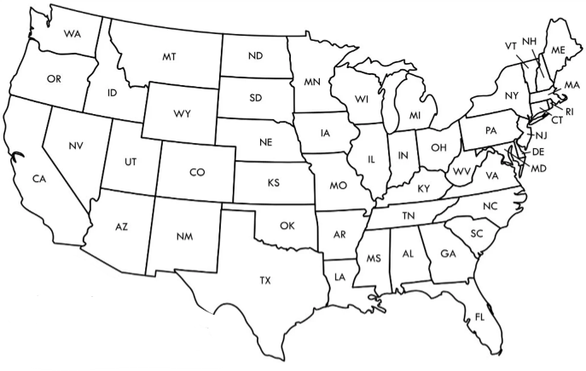
Market Translator
Notes:
Change to: Market Translator

Slide 63
Skilled Communicator
Notes:
Remove – Speak Their Language

Slide 64
Third-Party Storyteller
Pricing
Negotiating
Notes:
The title and the body of the slide seem to be at odds.
Heading should read: Third-Party Storyteller

Slide 65
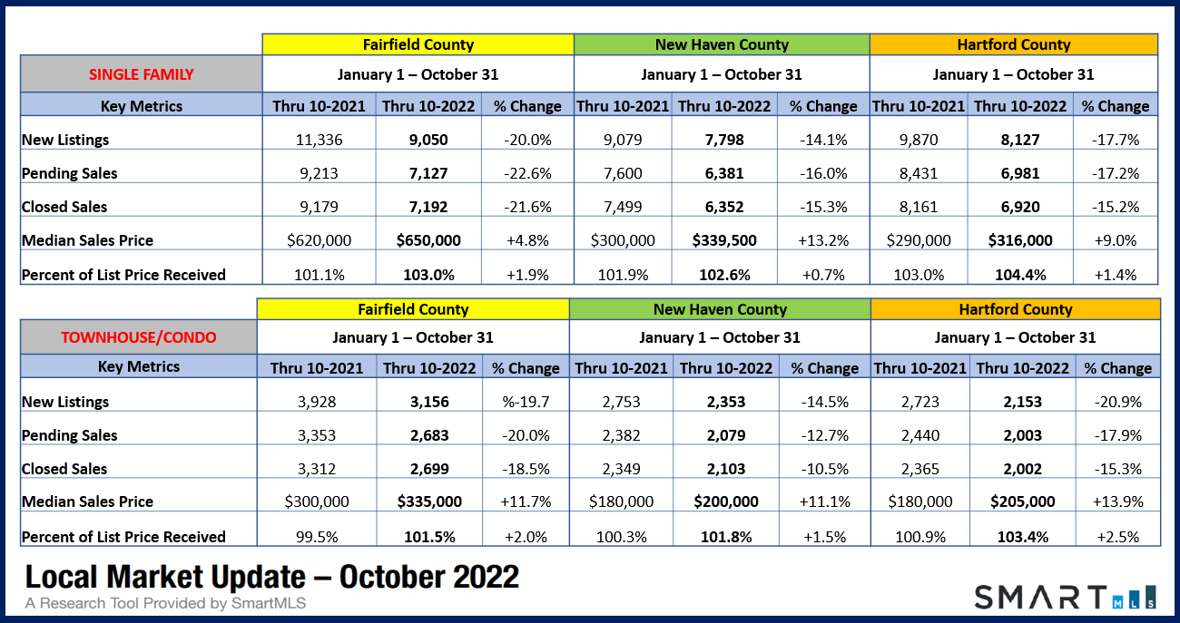
Value Provider
Share from our market update
Notes:
Change to Value Provider.

Slide 66
Be a Master
Focus
Notes:
Change heading to: Be a Master
Change body to ‘Focus’ – Find a picture of someone who is a Jack-of-all-Trades or someone who is overwhelmed by trying to do too much. It will juxtapose the word Focus. You may not even need the word if the graphic is good enough.

Slide 67
Enhance Relationships
Clients – 24 touches
Industry Professionals
Notes:
Change title to “Enhance Relationships”
Change Body to:
Clients
Industry

Slide 68
Financing Expert
Deal making
Buyers off the fence
Notes:
Change heading to “Financing Expert”
I don’t know that this wording in the body is what you want. It seems manipulative. I don’t think you need any words. You could also change the photo to a bank or a bank with a friendly person outside.

Slide 69
Online Presence
Notes:
Change title to: Online Presence
Remove the words in the body. The graphic is fine.

Slide 70
Be a Star
Scripts
Video
Notes:
Change heading to “Be a Star”
I think the graphic is ok. It may be better to show a film or tv set since you are going to talk about video.
It might be powerful to remove the wording and graphic in the body and play a sample video that is 30-45 seconds in length like Jeff does for our firm.

Slide 71
Work Listings Daily
Notes:
Change to “Work Listings Daily”

Slide 72
Real Estate Systems
Transactions
Listings
Buyers
Goals
Dreams
Notes:
Change heading to “Real Estate Systems”

Slide 73
Accountability Partner
Notes:
Change to ‘Accountability Partner”

Slide 74
Model
Notes:
Change to “Model”

Slide 75
W.I.N. the Year Strategy
Notes:
Change to “W.I.N. the Year Strategy”

Slide 76
RE/MAX Right Choice Success Formula
Notes:
Change heading to “Confidence”
Delete words in body of slide.

Slide 77
It’s Not Location, Location, Location
Confidence, Confidence, Confidence
Notes:
Change heading to “Confidence”
Delete words in body of slide.

