Slide 1
Win The Listing Scripts For Success: Luck Favors The Prepared!

Slide 2
Some Overall Comments
Most objections will repeat themselves over
and over during your career
b) In order to Win Listings you need to be able to
master objection handling with knowledge
and confidence
c) You have to tune in to non-verbal signs

Slide 3
Some Overall Comments (Contd.)
d) You have to learn to be a great listener –
There is a reason God gave us two (2) ears
and one (1) mouth
e) They must feel that you are focused on
what’s most important to them - you have to
build their trust
f) You have to learn to mirror their personality profiles

Slide 4
Some Overall Comments (Contd.)
g) Always, always, always acknowledge their
objections -
I can appreciate that, I agree, I understand, That’s a valid concern
I caution you against using the word “but “ when you are acknowledging their concerns as it may appear like you are challenging them

Slide 5
Some Overall Comments (Contd.)
After you have said I agree, or I understand you can use the word “and” as a segue into your comment
That way you will be able to smoothly transition into your objection handling
You may also consider asking them to be specific about how they feel or what is making them feel that way

Slide 6
Some Overall Comments (Contd.)
You also may ask a question along the lines of feel, felt, found - Has there ever been a time you felt like this?
We need to do whatever we can to connect with them - to gain their trust and confidence to Win the Listing

Slide 7
Some Overall Comments (Contd.)
Not all of our responses to objections will be handled the same way because we have to read the individuals we are dealing with and what the overall situation may be
What should be consistent is our professionalism, our demeanor and our confidence!

Slide 8
What is your elevator speech?
Most people hire me for one of three reasons:
One, they are concerned about getting full market value for their home
Two, they have a fear their house may not sell in the time frame they would like
Three, they were upset that the last realtor they hired did not make them feel like a priority

Slide 9
Upfront Contract
Mr. and Mrs. Seller thanks for having me over to talk about your house - I appreciate you thinking about me and RE/MAX Right Choice to help you sell your home
I wanted to check with you to see if you still have 30-45 minutes for our meeting today
Yes we do -
Great

Slide 10
Upfront Contract (Contd.)
I know you are going to have some questions for me and that’s great and I will do my best to answer them
And if it is ok with you, I will have some questions for you as well
Great

Slide 11
Upfront Contract (Contd.)
When we are thru today you will typically know if we are a good fit and if we are, we will figure out what the next steps are ...........and if we are not a good fit that is totally ok as we are not a great fit for everyone and we will not push it
Fair
Great -

Slide 12
COMMON OBJECTIONS

Slide 13
1. Price Is Not High Enough
I totally understand how you feel
Almost every seller I’ve represented felt the same way
We all found it was not up to us – the market dictated
Buyers are experts on market value in your price range
Strategically a critical decision for both of you (seller and listing agent)

Slide 14
Know The Market Numbers
Absorption stats
Average time on market

Slide 15
Grocery store different boxes of pasta
NAR stats 10-15 showings
Sell the house 4 times

Slide 16
2. I Want To Pay Less Commission

Slide 17
One of the four important items you control
Relocation companies, banks
Office policy – my policy

Slide 18
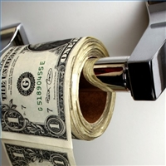
Why most sellers never question my fee
If an agent will reduce their professional service fee for you, what will they do for you when they negotiate?

Slide 19
3. I Only Want A 60-90 Day Listing

Slide 20
Why and be quiet listening for the answer
The minimum listing period our office / I take is 180 days…
You are in control of: price, condition, commission

Slide 21
4. I Have A Friend/Relative In The Business

Slide 22
Everybody does – 1,000,000 plus Realtors
All your strategic decisions need to be correct in this market
Largest asset

Slide 23
Make the best decision for you and your family
Do you want your financial and personal life exposed to family/friends

Slide 24
5. I Want To Fix It Up Before We List

Slide 25
Let’s do the paperwork now
Your buyer may be in town this weekend while you are cleaning the yard
Let us get the word out today

Slide 26
6. I Want To Build In Negotiating Room

Slide 27
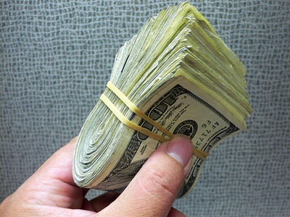
Market dictates value
First two weeks are critical
Fishing frenzy

Slide 28
7. I Can Always Come Down In Price

Slide 29
Everyone can but in today’s market it does not work….buyer’s will question why it did not sell
A reduction might go unnoticed
Chasing the market….

Slide 30
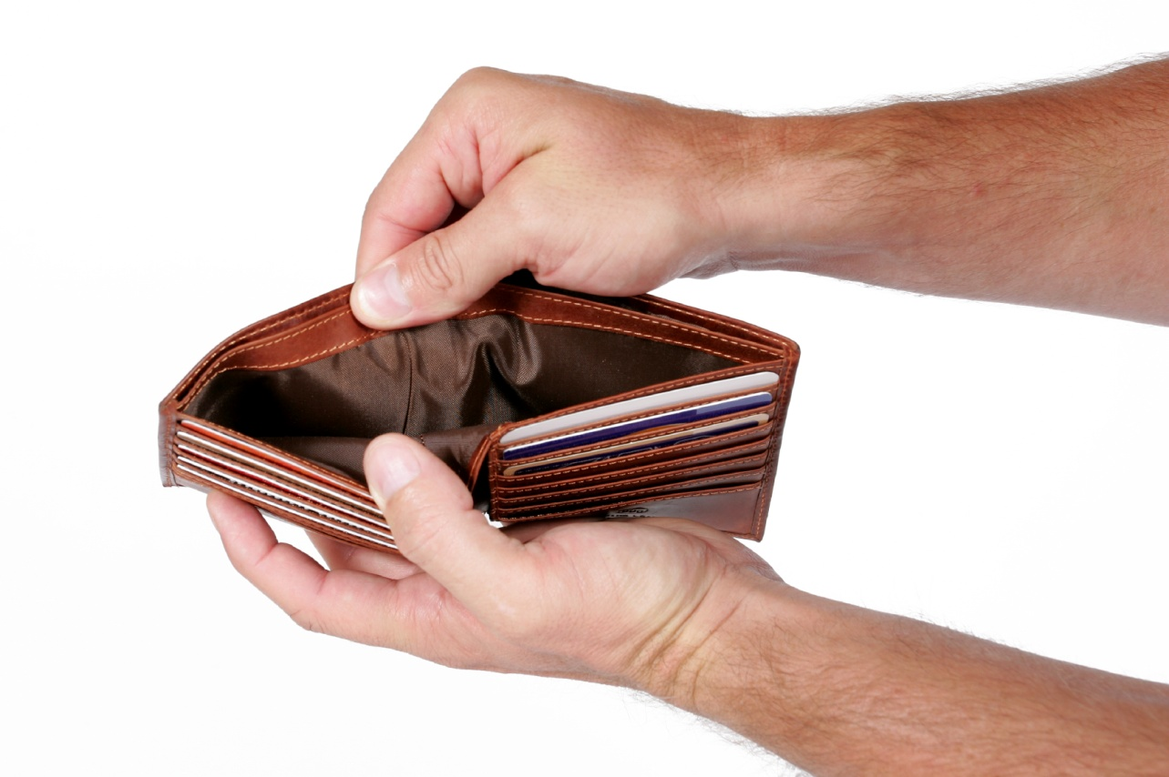
8. We’re Not Giving It Away

Slide 31
I totally agree you should not
Do we agree the market changes
If you bought stock at $100 and today it is selling at $80…

Slide 32
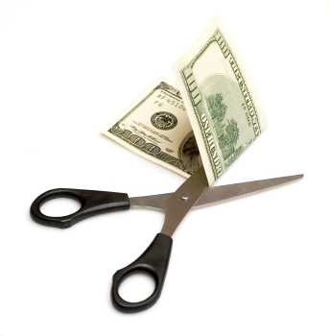
9. If I Sell With You And Buy From You
Will You Lower Your Commission?

Slide 33
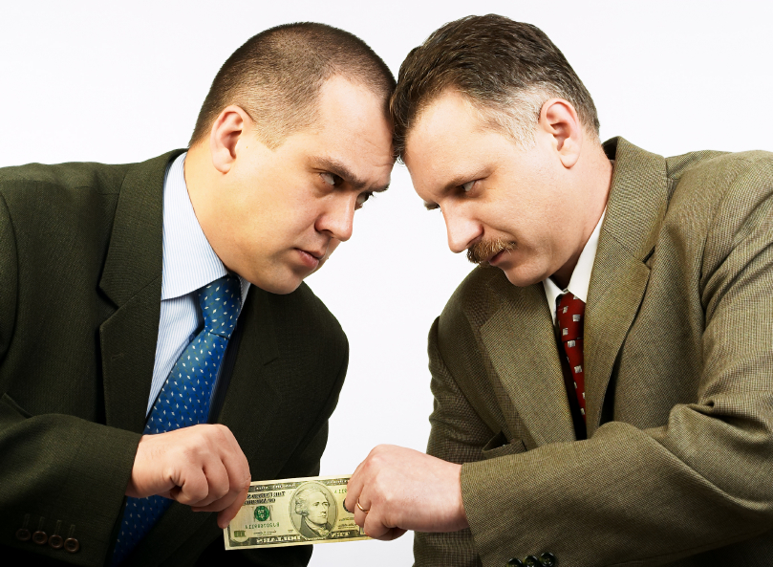
NO
Two transactions: two knees, two hips, two cavities
Two separate goals:
Selling – highest value
Buying – lowest value

Slide 34
10. I Want Ads Everywhere To Include The New York Times

Slide 35
10 years ago correct strategy, today little result
Internet
National brand exposure
We know what we have to do to get a property sold

Slide 36
11. I Will Wait To Sell When The Market Goes Up Further

Slide 37
Nothing you can do
Major question when you sell:
Buying up
Buying down
Renting

Slide 38
12. You Are Too Busy To Handle My Listings With All Of Your Clients

Slide 39
Major advantage, busy is good
Surgeon who did 10 operations or 1,000
Who do other sellers entrust their sale to

Slide 40
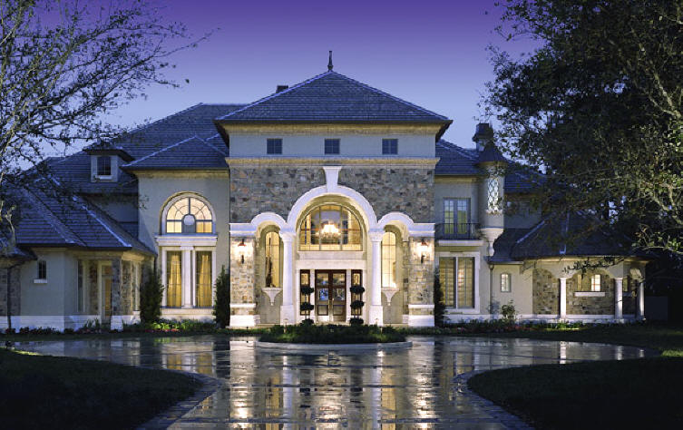
13. You Do Not Handle Homes In My Price Range

Slide 41
Tricky if you do not handle higher priced properties
Demonstrate your knowledge by learning the market
Most important they trust you and your knowledge

Slide 42
14. I Want To Know Where I’m Going Before I Sell
That would be ideal
2 houses very risky for most
Sale is subject to finding satisfactory housing
Price properly and we will learn the market simultaneously

Slide 43
15. We Promised Two Other Agents We Would Interview Them Before We Make A Decision
Can I ask you a few questions
If you had not promised two other agents would we be filling out the paperwork right now
If yes, there is a reason for that - comfort, trust and having an expert is critical today

Slide 44
If no – what did I say that was not acceptable (isolate the objection)
Let me explain why
I will cancel the other appointments

Slide 45
16. Why Should I List With You If You Never Showed The Property When It Was On the Market Before

Slide 46
My job is to execute a marketing plan
I will most likely not be the agent that sells the property, but I will be the reason it sells from the exposure I create
I know that is what you care most about – getting your house sold and I believe I can do that

Slide 47
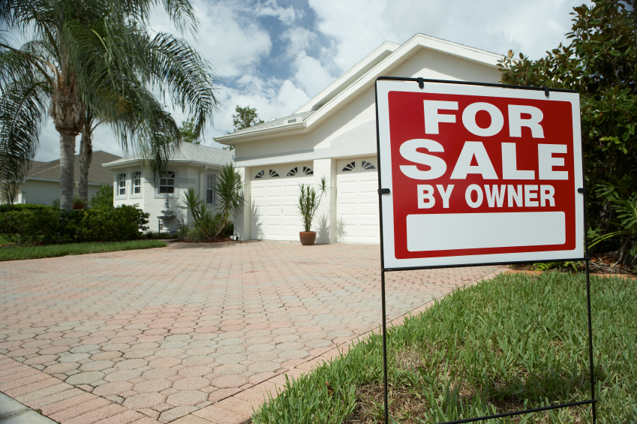
17. We Want To Try To Sell It On Our Own
Why would you want to do that?
Three important things to realize
How marketing and creating massive exposure has changed
Liability exposure
Most buyers want to save the same commission your want to save – who wins

Slide 48
NAR stats
FSBO list to sale ratio is much lower than
what realtors are achieving
Most FSBO list…

Slide 49
18. Your Office Is Not In Our Town
That used to be a concern
The internet has changed all that
Bricks and mortar offices are shrinking

Slide 50
We all have access to important community and school data at our fingertips
I know how to price and sell real estate
Is that not what is most important

Slide 51
19. We Want To Think About It
Can you please elaborate
Is there anything I can further explain
What would keep you from getting started right now

Slide 52
20. We Cannot Lower Our Price Anymore
I understand
I wish you and I could control what is happening in the economy and specifically in our market

Slide 53
Let’s explore your options
Stay put and wait for the market to come
back
Lower the price – hopefully it works and minimize the damage
My job is to tell you the truth

Slide 54
21. We Will Wait For A Better Offer

Slide 55
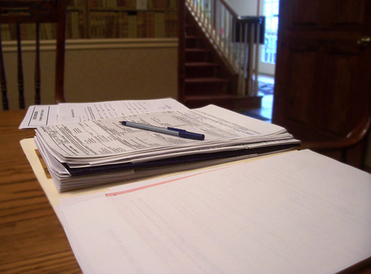
I am a student of the real estate industry – the great majority of the time the first offer is the best
The Smiths, the Jones, the Dearborns
If it’s a unique property you may only get one offer

Slide 56
When you prepare well
Your luck increases,
Your confidence increases,
And your success increases.
Prepare well.
Jeff Wright

Slide 57
Concluding Thoughts
You don’t have to be great to start, but you have to start to be great.
~ Joe Sabah

