Slide 1

Selling New
Construction

Slide 2
New Construction
Almost all new construction transactions require more involvement on the part of an agent than resale transactions, and, often, the commission rates are lower.

Slide 3
Negotiating New Construction
Typically, there is not as much negotiation with new construction as there is with resale. Part of the reason is when you negotiate 5% with new construction the 5% may represent 33% of the profit.
If builders have other homes they are selling in the same development/community, negotiating the price down affects the sales price of their other future properties. In lieu of negotiating down they may offer to pay for upgrades or give closing cost credits.
  “The buyers shall receive a credit towards closing costs and prepaids at the time of the closing in the amount of $23,792.00.”
If a builder has inventory sitting as a stand alone house it will be easier to negotiate if that new home has been sitting on the market.

Slide 4
Representing a Buyer
The process is not straight forward
Lot location
Floor plan
Specifications

Slide 5
Offer
Obligation to purchase is subject to formal contracts being executed.
Obligation to purchase is subject to seller and buyer agreeing to a final house plan, specifications, and price. House plans and specifications are to be included in the contract of sale.
Purchaser shall have the right to perform a building inspection at their expense, prior to closing. The seller is responsible for only repairing those items that are not in compliance with the local building codes.
Purchaser shall have the right to perform a radon inspection at their expense, prior to closing. If the results are not in compliance with the EPA minimum standard of 4.0, seller will be responsible to install at the seller’s expense a radon mitigation system to bring the test results in compliance with the EPA standard.

Slide 6
Specifications
Every Builder is different. What is standard for one might be an upgrade for another.
In new home developments with model homes, many times options/upgrades are shown and you need to make sure your clients know these upgrades come at a cost.

Slide 7
Specifications for Constructions
Easton Woods 2, Easton, Ct
General Specifications
General Conditions
Site Work, Driveway, Landscaping
Foundation and Concrete
Moisture protection
Insulation and Ventilation
Masonry
Metals
Carpentry
Roofing
Drywall
Windows, Doors, Staircases and Millwork
Electrical
Exterior/Interior Painting and/or Staining
Flooring
Cabinetry and Appliances
Plumbing
Heating and Air Conditioning
Miscellaneous

Slide 8
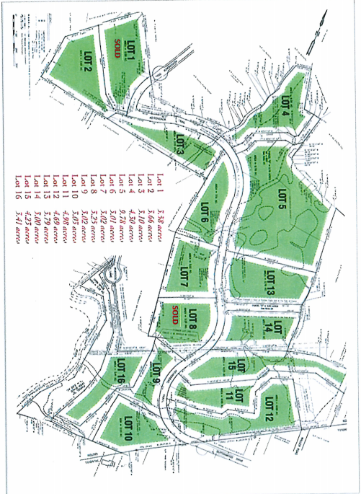
Site Plan

Slide 9
Septic Plan if Applicable

Slide 10
Septic System As-Built

Slide 11
House As-Built

Slide 12
Declaration of Restrictions and Covenants
It is the objective of the declarant to ensure that the premises contains a variety of tastefully designed traditional homes of high quality of at least 3,800 square feet of living space exclusive of the basement, garage, or outside porches. The primary purposes of the restrictions and specifications set forth in this document is to convey an overall impression of the general quality level required in homes to be constructed and at the time to provide maximum flexibility for each lot owner to exercise individual creativity and personal taste.
All rules and regulations under the zoning ordinances of the Town of Easton, applicable to the premises, shall be observed and complied with.
The Lots shall be used and occupied for residential purposes only.
No poultry or domestic animals except a total of two dogs or cats (not two dogs and two cats) may be kept maintained on a Lot, and they shall be quartered within the family dwelling at night.

Slide 13
Warranties
In CT there is a statutory one-year warranty with all new home construction.
Additionally, there are items like roof, appliances, hot water heater, etc. that have much longer warranties.
Sometimes a builder uses a third – party warranty company for other components of the house.
At the time of closing, you should receive all warranty information.

Slide 14
Basement Water

Slide 15
Contract Warranty Language

Slide 16
Statement of Non-Warrantable Conditions (From Seller’s Attorney)

Slide 17
Get The Home Inspected
Even though most municipalities require new homes to pass permit inspections you should still recommend a home inspection.
I write in the offer that the builder agrees to repair code compliance issues, but the buyer would not have the option to walk away from the deal.

Slide 18
Contract to Purchase
Hopefully the buyer’s attorney is a real estate attorney who has experience with new construction. The new construction purchase contract has all the same things you find in a resale contract plus the following:
CT Department Consumer Requirements for New Home Construction Contracts

Slide 19

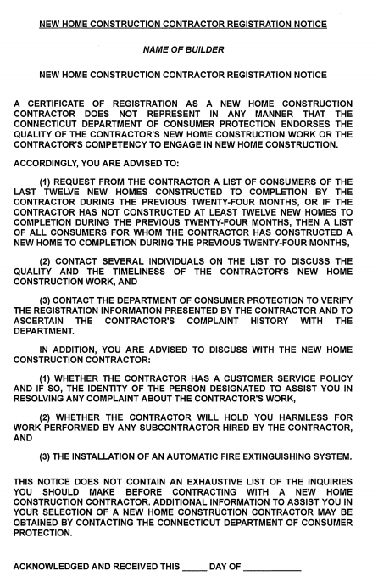


Slide 20
A copy of the Contractor’s New Home Construction License – not just the license number but actual copy of the license – is to be attached to the contract.

Slide 21
•The following statement must be included in the
contract:
The Buyer acknowledges that Buyer may be contacted by future customers of the Contractor regarding the timeliness and quality of the Contractor's work, unless the Buyer indicates in writing at the time of execution of this contract that Buyer prefers not to be contacted.

Slide 22
DCP – New Construction Website Link
•This is the link to the website. In addition to allowing you to look up, and verify, a contractor’s license, this website provides other helpful information and resources.
https://portal.ct.gov/DCP/Trade-Practices-Division/New-Home-Construction-Information-for-Consumers

Slide 23

Varies by the customs of the different counties throughout CT and by the builder or developmental project.
At contract signing time most builders would like to have their full financing down payment if it is less than 10%. If the down payment is greater than 10%, they require 10%.
If changes are made during construction especially with upgrades many times the builder will require 50% or greater of the upgrade cost paid at the time the change has been ordered.

Slide 24
Changes Additions
All changes, additions, and/or verbal agreements need to be put in writing.

Slide 25
Extras

Slide 26
Commission Calculation For Extras
**Must Be Spelled Out
3. Purchase Price: The “Purchase Price” is ONE MILLION SIX HUNDRED SEVENTY-TWO THOUSAND DOLLARS ($1,672,000.00) payable as follows:

Slide 27
Final Walk Thru
Find a way to mark any items that need to be addressed. Take photos and follow-up in writing with the builder, the buyer, the attorneys, and the realtors.

Slide 28


Slide 29
Closing Date
Closing dates sometimes are a challenge: Weather, Municipal Inspections, Contractors, Materials, Lender Timing, Certificate of Occupancy.

Slide 30
Researching the Builder
Visit other developments
Talk to homeowners
Search online for reviews, testimonials, and news

Slide 31
Waiver of Mechanics

Slide 32
Selling a home that has not been started: Custom
Things that need to be addressed:
A) Does the builder or buyer have a plan that works for the budget
B) If an architect or designer is required who will pay the design fees
C) How does the lot get secured - deposit, letter of intent, MLS form
D) Once a plan, specifications, and price are agreed to then the previously discussed new home contract can be drafted and executed

Slide 33
Bringing a Builder a New Home Client Opportunity for a Custom Home
A) All of the same apply from the previous slide
B) You need to make sure you have a conversation with the builder about the commission you are looking to be paid, and put in place a signed commission agreement, prior to your client meeting with the builder.

Slide 34
New construction purchase financing for a spec home that can be delivered in 60 days:
Everything is typically the same as if you were purchasing an existing house except the appraiser will need a copy of the house plans, the specifications, and the contract of sale.
If the house is not completely finished the appraiser will need to come back out prior to closing to verify exactly what the contract says is being included.

Slide 35
New construction financing for a home that cannot
be delivered for 90-360 days:
The bank will do a preliminary appraisal from the plans and specifications, and the appraiser will need to come back out prior to closing to verify exactly what the contract says is being included and reappraise the property.
The bigger challenge is a builder will not typically start building a custom house without having a contingent-free contract. As we know financing can be locked in for 60 days, so the buyer has to be willing to waive their mortgage contingency and put deposit money at risk.

Slide 36


Concluding Thoughts
You don’t have to be great to start,
but you have to start to be great.
Joe Sabah

