Slide 1
Selling Land

Slide 2
Trumbull Planning and Zoning Commission
The Planning and Zoning Commission consists of five elected members and three alternates appointed by the Town Council. It is the function of the commission to enact and amend the zoning regulations, to control and direct the most appropriate use and development of land throughout the Town, and to adopt and amend a Plan of Development which sets the policies, goals and standards for the physical and economic development of the Town.
The commission conducts monthly public hearings on proposals for subdivisions, special permits, changes in zone classifications, and amendments to the zoning regulations.
The commission also recommends the acceptance of streets into the Town road system, acts on the reduction and/or release of bonds for subdivisions and site improvements and renders reports on proposed municipal improvements.

Slide 3
Inland Wetlands and Watercourses Commission
As a regulatory agency, the commission evaluates the wetlands in Town and acts on any permit requests affecting designated wetlands. Public hearings are conducted on those proposals deemed to be "significant activities". The commission conducts a field investigation of all properties in question for the purpose of a first-hand observation of the existing wetland or watercourse.

Slide 4
How are Wetlands and Watercourses Defined in Connecticut?
We usually identify wetlands and watercourses using the familiar terms marsh, swamp, river, brook, pond or lake. However, the CT Inland Wetlands and Watercourse Act (Act) defines wetlands by soil type . The soil types of wetlands are poorly drained, very poorly drained, alluvial, and floodplain.
Identifying wetlands by soils allows us to recognize those areas during times of drought when there is no surface water present, or during winter when characteristic wetland indicator plants may not be obvious.
Wetlands may not always appear wet. For example, all floodplain soils are considered wetlands regardless of drainage class and some floodplain soils can be quite dry.

Slide 5
Inland vs. Tidal Wetlands
Unlike inland wetlands which are defined by soil type and typically regulated by the municipalities of CT, tidal wetlands are defined in the Tidal Wetlands Act by their current or former tidal connection, and their capacity to support certain wetland vegetation. Tidal wetlands are regulated exclusively by the CT DEEP -- not the towns of CT.

Slide 6
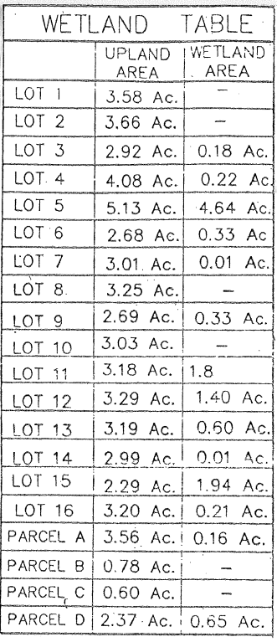
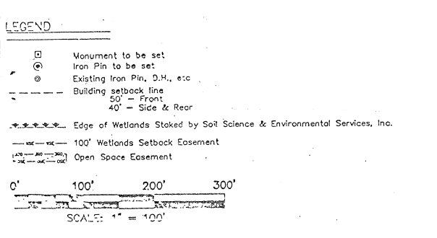

Slide 7
Zoning Boards of Appeal
The Zoning Board of Appeals has monthly public hearings on petitions for Special Exceptions variances of the zoning regulations and appeals from orders of any official, who is charged with enforcement of the zoning regulations.

Slide 8
Approved Subdivision Map
The full subdivision map Is on file in the local municipal planning and zoning office. Typically this includes the site plan , the infrastructure detail, location for septic plans and wells if applicable, wetlands mapping etc.
The tax assessor has a copy of the recorded record subdivision map that has all the property line and easements included.
Note: In order to fully understand what someone is purchasing they need to visit the site and walk the land because google maps and reading the map alone will not give you a full understanding of the slopes, the topography , the privacy or lack thereof and the overall views of what you see.

Slide 9
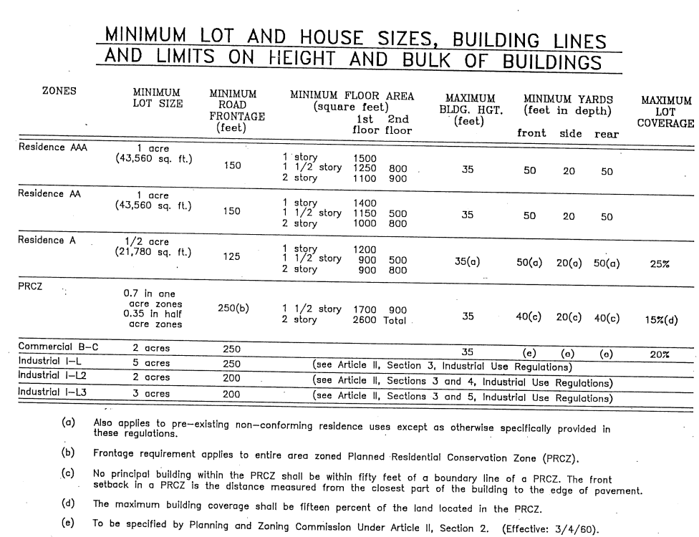
How Does a Subdivision Map Get Developed

Slide 10
The Subdivision Site
Every subdivision site is unique. Each has different physical features – soil, percolation, topography, tree cover, and access.

Slide 11
The Subdivision Site (Cont’d.)
Three types of data must be determined to adequately evaluate subsoil conditions:
The percolation rate of the soil
The ground water table elevation, and
The types of soil present, including any rock formations

Slide 12
Percolation – PERC Test
The percolation rate of the soil is a measure of the rate at which the soil can absorb water or sewage effluent.
The rate is determined by the performance of the percolation test measuring the rate at which water is absorbed in minutes per unit of drop.
To be valuable, the test must simulate the same conditions under which the soil will function after the sewage system is constructed.
This means the soil must be tested as it will function when saturated, because the soil will always be in a saturated state when the systems begins operation. The hole must be filled, the water drained substantially, and the hole refilled before measurement begins. This will then result in a proper determination of the percolation rate.

Slide 13
Percolation – PERC Test (Cont’d.)
A percolation test indicates adequate seepage qualities if the soil absorbs water at a rate of 1 inch of drop in less than 30 minutes.
Obviously, the fewer minutes required per inch drop, the better the seepage. The faster the absorption rate the smaller the absorption area required for a fixed number of gallons of water. Therefore, the faster the percolation rate the smaller and more economical the sewage disposal system.
The Connecticut health Department has established certain minima for sewage system sizes per bedroom for various percolation rate is less than one inch in 30 minutes depends somewhat on the causes for the low rate.
If it is caused by high ground water table, it could be corrected by a curtain drain.

Slide 14
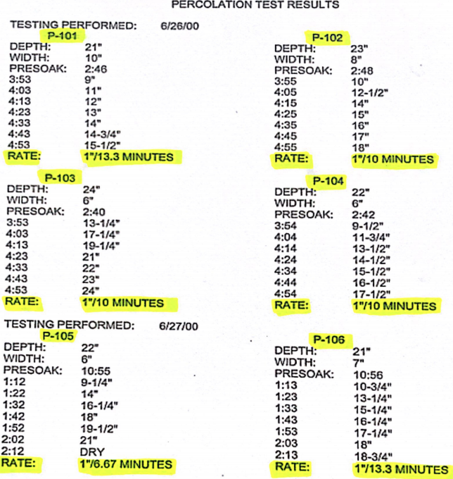
Percolation – PERC Test (Cont’d.)

Slide 15
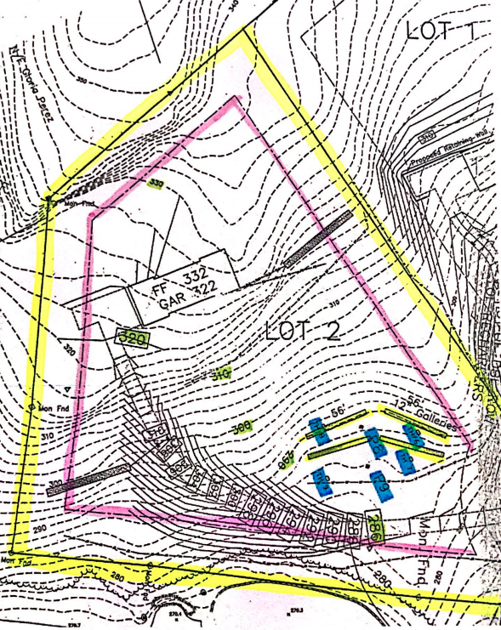
Percolation – PERC Site Plan

Slide 16
Water Table
The second type of data necessary for the proper design of a subdivision is a measure of the ground water table elevation. This is most easily obtained by digging a hole 7 to 8 feet deep and observing the depth below ground surface at which ground water appears.

Slide 17
Water Table (Cont’d.)
When a high ground water table is encountered, several problems affecting just about every area of subdivision construction, can be anticipated:
Sewage disposal systems will not function in saturated soil; therefore, the bottom of the trenches or leaching field must be kept 18 inches above the maximum ground water table.
Basements will flood unless drained and waterproofed properly. Curtain drains and footing drains should be installed in accord with good engineering practice.
Roadway and driveway pavements will crack, heave and fail because of wet subbase conditions unless the ground water is removed properly.
Site grading will be troublesome because of water bleeding through the surface in “cut” areas.

Slide 18
Soil Type
Soils information is the third type of data necessary to design a subdivision.
Soil may be generally classified as: loam, rock, gravel, sand, clay or silt.
Loam is that is that soil which is “topsoil” and contains the elements and materials necessary to sustain plant growth.
Rocks need no explanation.
The remaining soils are classified according to the particle sizes of which they are composed. In descending order of particle size, the soil gradations are gravel, sand, silt, and clay. As the particles become smaller, in silt and clay, the soil becomes more cohesive, holds moisture better, and exhibits poor percolation qualities.

Slide 19
Soil Type (Cont’d.)
As in the case of ground water determination, soil types can best be ascertained by digging a hole 7 to 8 feet deep. For expediency, one hole is dug for ground water and soil determination.
The depth of 7 to 8 feet is chosen because subdivision construction seldom goes below this depth.

Slide 20
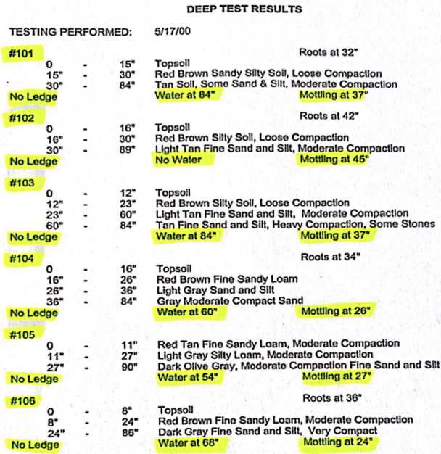

Slide 21
Reading A Map
Map Legend
The map legend is our guide to understanding the markings that occur on the map and delineates things that are required to be identified as part of the subdivision approval process.

Slide 22
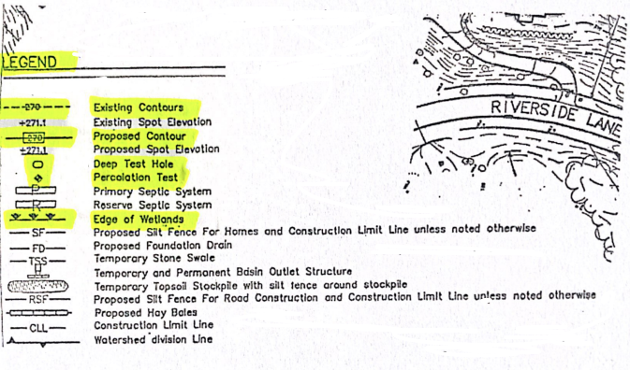
MAP LEGEND

Slide 23
MAP LEGEND

Slide 24
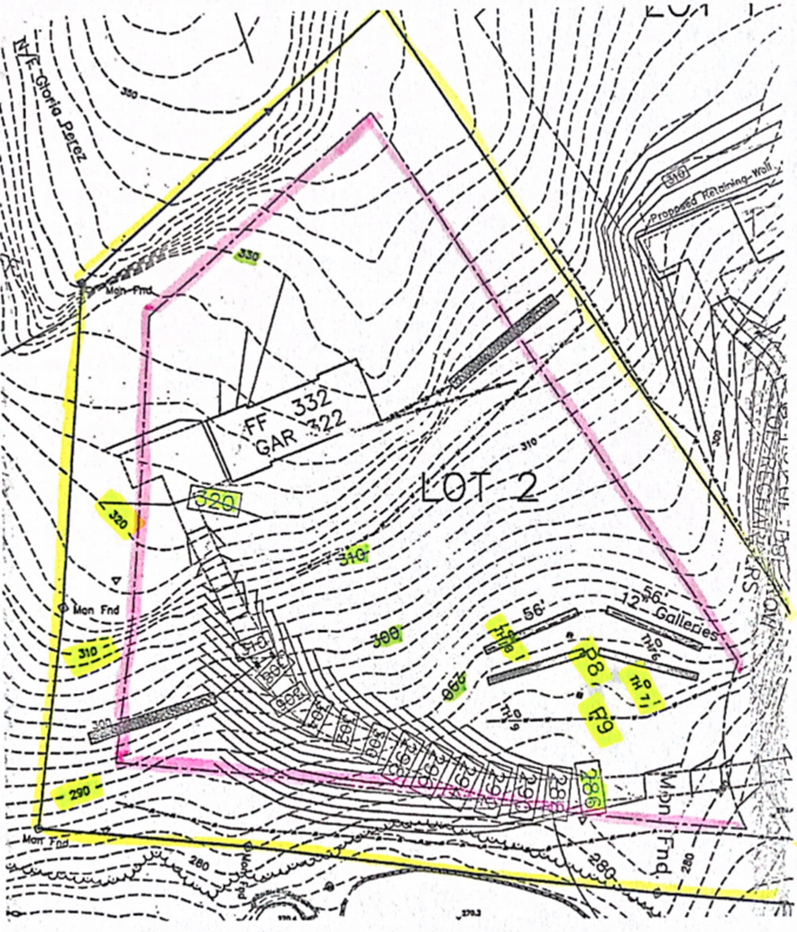
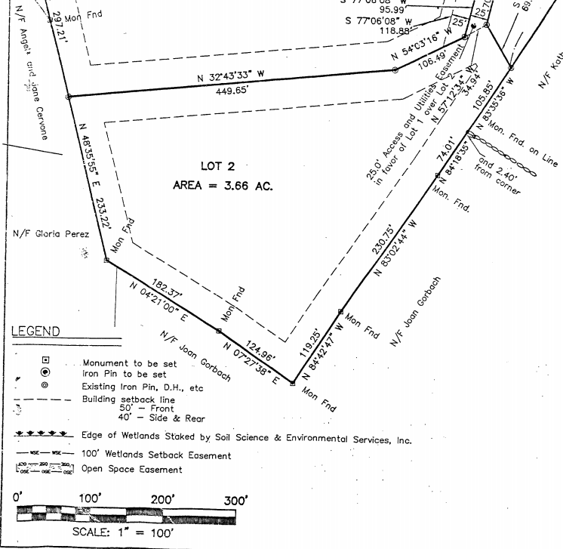

Slide 25
Searching For A Lot
Questions you should consider asking:
What is the ideal size of the lot and the minimum size of the lot: 1.5 – 2 acres?
Do you want a level lot or gently sloping to the back to accommodate a walk out lower level with natural window light?

Slide 26
Searching For A Lot (Cont’d.)
Do you want room for a pool now or in the future?
Do you want room for a tennis court?
Do you want a storage building?
Do you want to be able to have horses etc?

Slide 27
Searching For A Lot (Cont’d.)
G. What size would you like the house to be:
i.e. 3000-3590 SF?
H. How many bedrooms?
I. Do you want sewer or septic?
J. City water or well?
K. Natural gas, oil or propane heating?

Slide 28
Searching For A Lot (Cont’d.)
What town and area of town are you interested in?
Do you care if the property has wetlands?
Do you care if the property is in a flood zone?
Do you care if the property is in a Restricted or an Unrestricted Subdivision?
Do you care if the surrounding area is zoned differently than residential?

Slide 29
Where Can You Find A Lot
MLS
A development that has not been placed on MLS
Tax assessors have property coded by vacant land
Land Engineers and land Surveyors
Tear down opportunities
Planning and Zoning office
Free Cut

Slide 30
Making An Offer On A Lot
Obligation to purchase is subject to the following:
a) Formal contracts being executed
b) Perc and deep hole tests results must be acceptable to the buyer whether they are the existing tests or new tests. If new tests are to be conducted the buyer will be responsible for the costs of the test.
c) The purchaser must be able to obtain a building permit for a minimum of a 4 Bedroom house.

Slide 31
Free Cut
If a property has not been subdivided from the time the original Planning and Zoning regulations were adopted ( in Monroe, CT it was 1955) a homeowner can get a free subdivision of their property as long as both properties have the acreage, frontage and setbacks to be In compliance with the current Planning and Zoning regulations .

Slide 32
Land Financing
A) Lot - Not all lenders will finance residential land. The down payment varies for those that do and today I am aware of a few lenders who require a 25% down payment
B) New construction financing - Not all lenders will finance a custom new construction home but some will and it is called a construction permanent loan.
During the construction phase you are paying interest only and you receive construction advances on an agreed upon schedule until the house is built and then the loan converts to a conventional permanent mortgage.

Slide 33
Spec Formula 25%-33% of Final House Price
Most builders will pay somewhere between 25-33% of the price their spec house would sell for.
If a house will sell for $650,000 they will pay between $162,500 and $214,500 for the land depending on their site costs, soft costs and what they want to earn.

Slide 34
Representing a Builder Purchasing a Lot
Work Backwards:
A) What price can you sell in the existing market?
B) What is the square footage of the house, the style, the level of finish--how much will it cost to build?
C) What builders fee and/or profit do they require?
D) If you know the answers to A, B, and C then you can calculate how much a builder can pay for a lot.

Slide 35
Representing a Builder Purchasing a Lot (Cont’d)
Other factors to consider:
A) The ideal product is something that is in the low to middle end of the market. Offering a great new home at a low to mid-market price will be very attractive. The high-end spec has more risk and more reward.
B) You need to understand features such as kitchen cabinet and room colors that are current, what you need electrically for genius stations, black windows vs white windows, etc.
C) Speculative financing is still limited since the last housing crash, so the builder has to self-fund or have investor and/or financing sources available.

Slide 36
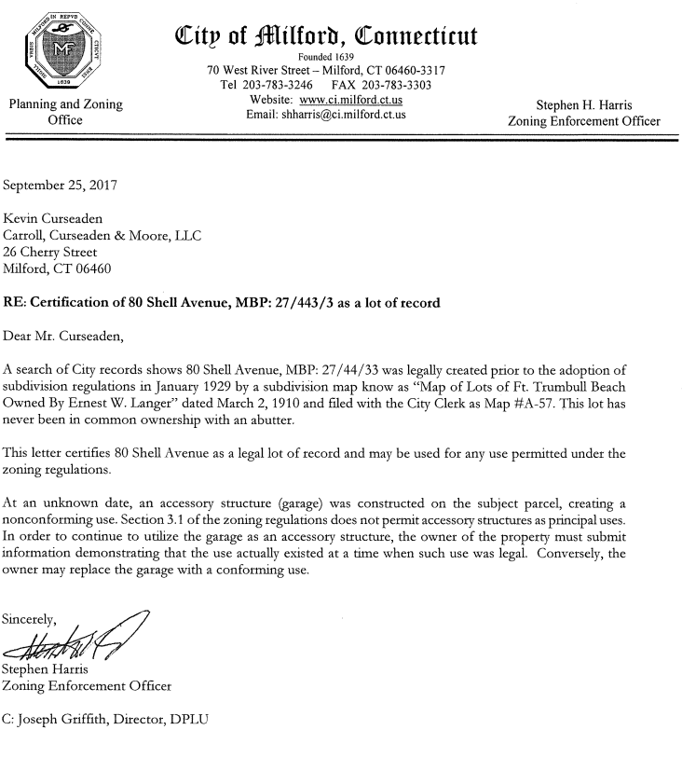

Slide 37
Major Learning Points
A) You and your client need to always perform your due diligence and check with the
appropriate municipal offices to verify that your client can build what he or she desires.
B) Make your offer subject to being able to get a building permit for a certain sq. footage and
bedroom count
C) Verify If there are any deed restrictions that a buyer must comply with
D) Verify the utilities that are available to the lot
E) Verify if there are any easements on the lot
F) Verify if the property is in a Flood Zone and what the Flood Insurance will cost
G) Verify If the road is public or private and will public services be available - posing, school
buses, etc.
H) Verify the front , back and side setbacks for the lot
I) The acreage does not determine the value
J) The number of approved lots does not solely indicate the value - you need to also know
the infrastructure/ site costs

Slide 38
Concluding Thoughts
You don’t have to be great to start,
but you have to start to be great.
Joe Sabah

