Slide 1
Pricing
Boot Camp

Slide 2
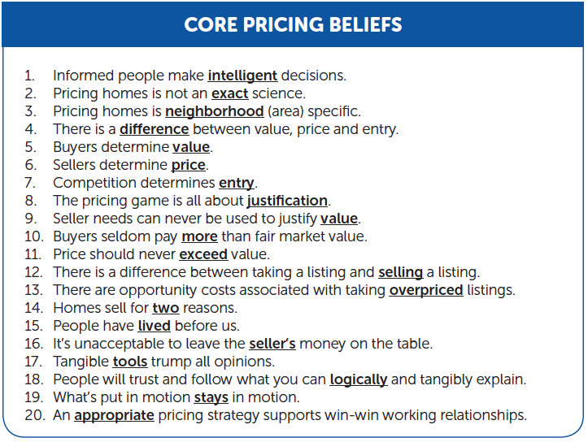
Check Your Attitude

Slide 3
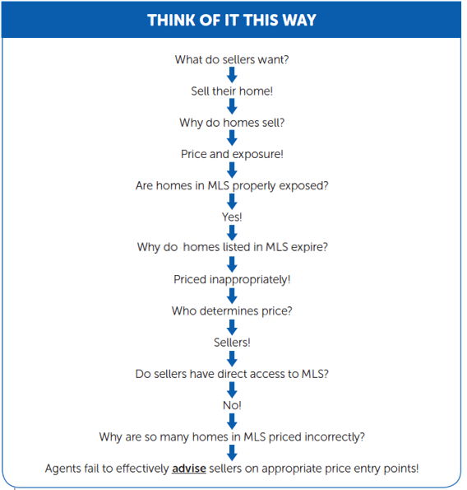
Becoming A Pricing Strategist

Slide 4
Becoming A Pricing Strategist
Why do some agents fail in the process?
Lack of Knowledge - Agent possess incomplete information
Lack of Confidence - Agent submits to seller demands
Lack of Judgment - Agent thinks it’s only about taking the listing - Agent wants to leverage the listing

Slide 5
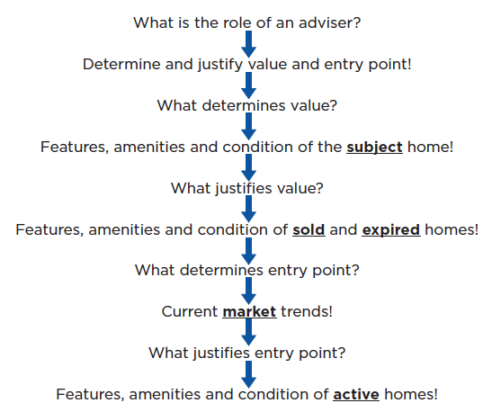
Facilitating Intelligent Decisions

Slide 6
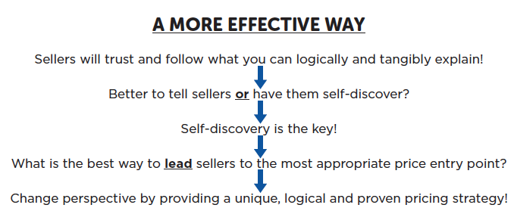
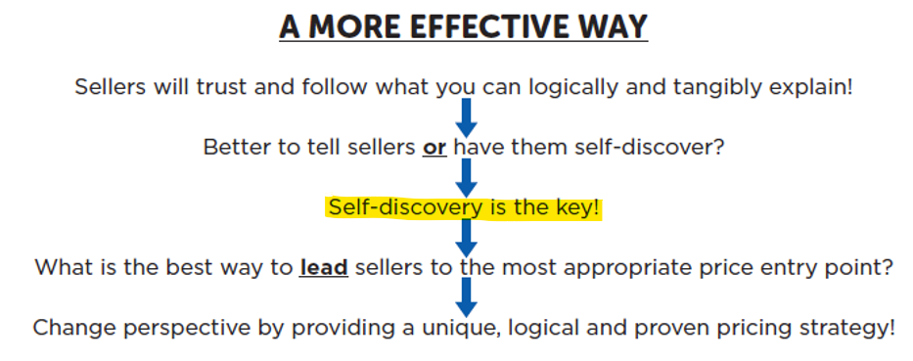
A More Effective Way

Slide 7
A More Effective Way
Conversations vs Presentations
Presentations work if the seller agrees with your opinion, they are not interviewing other top agents or they are in a dire situation.
Conversations start with questions which lead to sharing of information, exchanging ideas and hopefully leading sellers down a path of self discovery.

Slide 8
A More Effective Way
Unique vs Typical
Sellers expect help with pricing
The problem is most listing agents use the same approach to pricing.
In a seller’s eyes, where all agents appear the same, cost of service becomes the difference maker.
To separate from the pack you must use a unique, logical and proven pricing strategy.

Slide 9
Analysis of Your Current Approach
Most listing agents, and thus most sellers, believe pricing a home is simply accomplished by multiplying average price-per-foot by the square footage of the subject home.

Slide 10
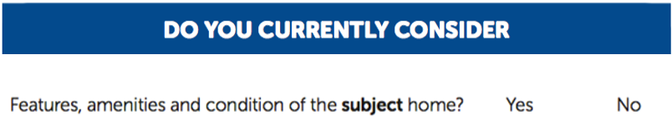
Analysis of Your Current Approach

Slide 11
Analysis of Your Current Approach
Don’t overwhelm the client with you ^{CMA.}
Instead, distinguish yourself by presenting a unique, understandable and complete set of pricing tools that revolve around crucial pricing considerations and allow for complete self-discovery by the seller.

Slide 12
Pricing Fundamentals
Important Definitions
Art and Science of Pricing: Leading Seller to the most appropriate price entry point
Opinion: Unfounded speculation (agent or seller)
Value: A home’s worth justified by historical data
Entry Point: Price that will net the most amount of money in the current market
List Price: Seller’s perception after review and analysis of pricing data. Note: The only way to change seller’s perception is to involve them in the pricing process

Slide 13
Pricing Fundamentals
GOLDEN RULE
List Price must be less than or equal to value
If list price exceeds value, the seller’s needs and/or wants are being used to justify the price. We all know the buyers don’t care what a seller needs or wants

Slide 14
Pricing Fundamentals
Knowledge always rules
There is a fundamental difference between you knowing the correct price entry point and sellers accepting it
Sellers control pricing decisions, so just because you know how to calculate an appropriate price entry point doesn’t mean your listings will sell
The key is NOT that we can give all the answers, but rather that you can ASK great questions, which in turn lead sellers down paths of self – discovery. One of the major factors in our listings selling is if the sellers follow our logic and they take complete ownership of the appropriate price entry point

Slide 15
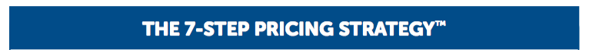
A Proven Pricing Strategy

Slide 16
A Proven Pricing Strategy
The 7-Step Pricing Strategy will not reveal a different end price than a typical CMA. It will, however, allow sellers a better opportunity to self-discover the most appropriate end price, which results in fewer objections and more win-win relationships.
It will take a little more time, energy and effort on your part. However, it is the only approach that ensures two very important things: Arrival at the appropriate price entry point and complete ownership of the appropriate price by the seller.

Slide 17
Determining Value (Range)
You must possess a broad working knowledge of pricing in the neighborhood and/or community!

Slide 18
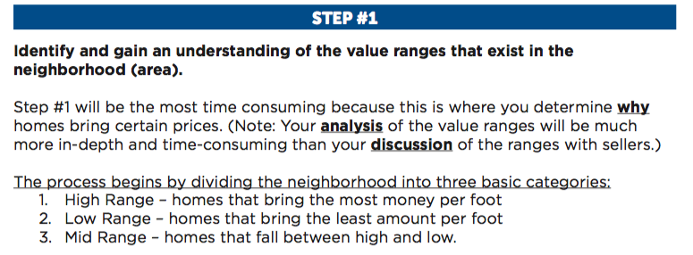

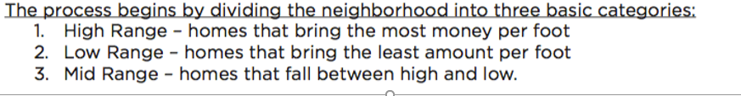
Determining Value (Range)

Slide 19
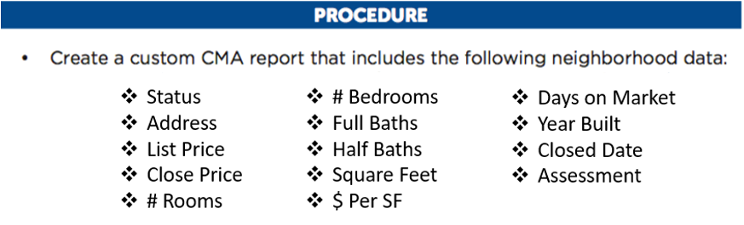
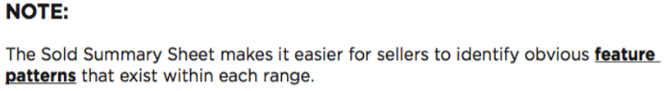
Determining Value (Range)

Slide 20
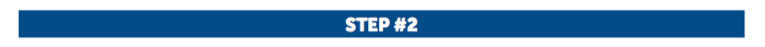
Determining Value (Range)
The same logic should apply to both sold and expired properties

Slide 21
Determining Value (Range)

Slide 22
Determining Value (Range)
Expired Listings represent the consequences of inappropriate pricing. Most homes expire because they were either listed in the wrong range or incorrectly positioned within the right range.
Pay close attention to homes that expired and then later sold.

Slide 23
Determining Value (Range)
This will be based solely on the features of the subject home and how it compares to the market.

Slide 24
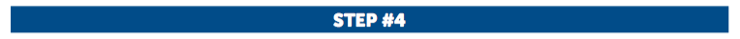

Determining Price (Position)
To determine the correct position, study the amenities and conditions of homes on the Sold Summary Sheet and the detail pages of the individual listings.

Slide 25
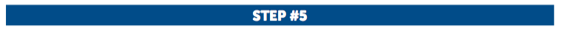
Determining Price (Position)
Verify the price position satisfies the seller’s financial need.
Once the subject home has been properly positioned within the right range, check to see if the agreed upon position will satisfy the seller’s financial needs. This step may entail calculating a net sheet for the seller.

Slide 26
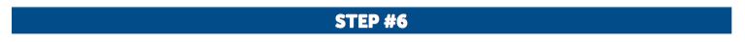
Determining Entry (Point)
Just because the seller’s price can be justified by previously sold and expired homes doesn’t mean that’s the price at which the home should be listed.
Competition and market conditions determine the entry point and thus must be carefully considered before determining exactly where to enter the market.

Slide 27
Determining Entry (Point)

Slide 28
Determining Entry (Point)
You are looking to see if there are similar or better homes listed at equal or lower prices. This step also helps determine if seller should enter the marketplace.

Slide 29
Determining Entry (Point)
If the seller needs a “quick” sale, the subject home must be priced below all true competitors. If the seller has no timing need, the home can be priced more aggressively. However, it’s still advised to stay within the “realm of justification.”

Slide 30
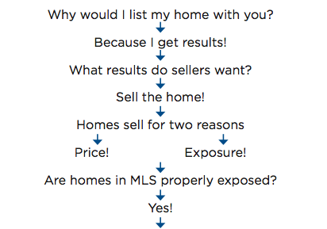
The Pricing Game Summary

Slide 31
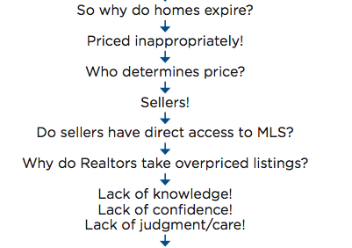
The Pricing Game Summary

Slide 32
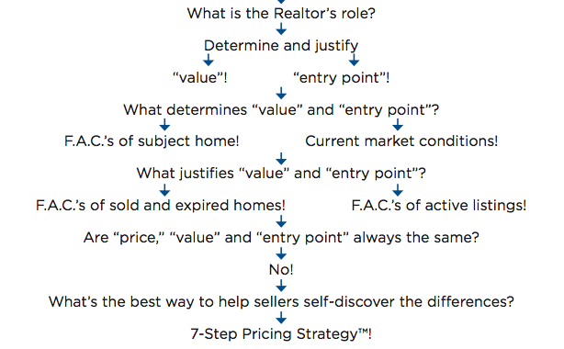
The Pricing Game Summary

Slide 33


Concluding Thoughts

