Slide 2
I. Commercial Property Types
Office Building
Retail Strip
Industrial
Mixed Use – Residential/Commercial
Life Centers/Power Centers
Ground Leases

Slide 3
II. Commercial Databases
Loopnet
CoStar
CERC
CTCList powered by Catylist
CREXI

Slide 4
III. Commercial Terminology/Concepts
1. Base Rent
Base rent is typically stated in terms relating to Net Net Net costs; that is Net of Taxes, Insurance and Maintenance.
Rents can be stated in various other ways to communicate how much of operating cost the owner owner will pay.
NNN = all costs paid by tenant
Gross = all costs paid by owner
Modified Gross = some costs paid by tenant

Slide 5
III. Commercial Terminology/Concepts
2. Useable s.f. vs. rentable s.f.
useable s.f. is the actual s.f. occupied by the tenant.
useable s.f. is multiplied by the core factor to get rentable s.f.

Slide 6
III. Commercial Terminology/Concepts
3. Core Factor
Loss factor (%): area in percent that
cannot be leased or occupied. (i.e. common area)
Core factor = 100%
100%-loss factor
Why?: Mathematical computation that spreads occupied space over all the space so the landlord has all gross building space being leased.
Example:
57,000 s.f. Building
7,000 s.f. Common Area, Elevator, Stairwells

Slide 7
III. Commercial Terminology/Concepts
3. Core Factor – Continued
What is the loss factor? 7,000 ÷ 57,000 = 12%
What is the core factor?

Slide 8
III. Commercial Terminology/Concepts
Common Charges
Otherwise known as building operating costs
Common charges comprised of: T-I-M
T = Taxes
I = Insurance
M = Maintenance also known as CAM, Common Area Maintenance (Building and maintenance grounds)
Just for a gauge, common charges may range from 2.50 to 12 psf depending on type of building, amount of common area and landlord philosophy

Slide 9
III. Commercial Terminology/Concepts
5. Total rent in a Commercial Lease consists of:
Base Rent
+
Common Charges
+
Utilities (electric, phone, gas, water)

Slide 10
III. Commercial Terminology/Concepts
Lease terms can vary dramatically but are typically:
3,5,10,15 or 20-year terms
“Options” typically of 5 years in length and
numbering 1 or 2 terms are also common in leases.
Escalations – year to year % increase to account
for cost of living increases.
Can be fixed to CPI – Consumer Price Index or Fixed Escalation model.
Escalation Models:
3% year to year
5% every 2 years
10% term to term
other

Slide 11
III. Commercial Terminology/Concepts
Tenant Improvement Fit-Out or Work Letter or Tenant
Improvement Allowance.
When space is raw or needs extensive remodeling for tenant, owner may pay for a portion of the capital dollars needed to accomplish the improvements.
The owner provides the tenant allowance as an
incentive to lease the space.
Examples of tenant fit-out allowance packages are:
$20 p.s.f. for 5-year lease
$40 p.s.f. for 10-year lease
Many other possibilities depending on the entire package of the deal.
Tenant may ask for the balance of the capital improvements to be included in the lease, that is often done and is calculated on a p.s.f. basis and added to the base rent.

Slide 12
IV. Offer Mechanism/Negotiations
Binder = Letter of Intent: (see sample and outline slides 19-26) Letter of Intent lays out all the business terms of the transaction.
Directly to Contract/Lease:
Typically the LOI is used to initiate the commercial transaction.
Major areas for potential negotiation:
Anything and everything……………………….
Space – square footage to be used
Base rent
Escalations or the pattern of rent increases
Lease term – the length of a term
Tenant Improvement Allowance or Work Letter
Options beyond the first term

Slide 13
V. Commissions
Usually paid off of base rent and rentable square feet.
Formula:
Square footage x base rent x # years x commission % = commission
Commission rate determined as follows:
(Typical but can be negotiated with owner)
When no other agent involved – “no co-broke”
1st 5 years - 5.0%
2nd 5 years - 2.5%
10 Plus years – 1.25%

Slide 14
V. Commissions (Cont’d.)
b) When another agent involved – “co-broke”
1st 5 Years: L.A. 2.5%
S.A. 2.5%
2nd 5 Years: L.A. 1.25%
S.A. 1.25%
c) When an “over-ride” is in effect – (larger deals big commercial brokers) applied to selling agent or tenant representative.
1st 5 Years:
L.A. 2.5%
S.A. 5.0%
2nd 5 Years: L.A. 1.25%
S.A. 2.5%

Slide 15
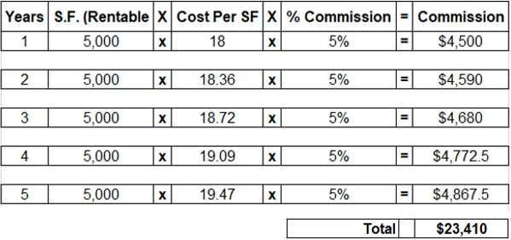
V. Commissions (Cont’d.)
Example: Determine Commission
5-year initial term
s.f. = 5,000 rentable s.f.
base rent = 18 NNN for 1st and 2%
increase years 2-5 year

Slide 16
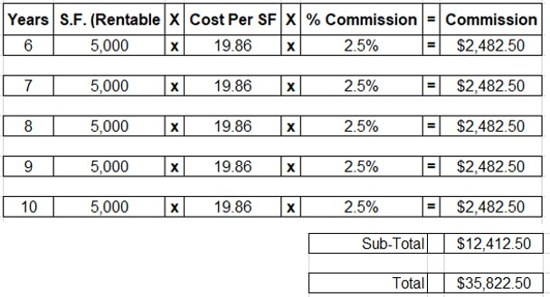
V. Commissions (Cont’d.)
Year 6-10: The base rent increases 2% in year 6 and remains fixed years 7-10

Slide 17
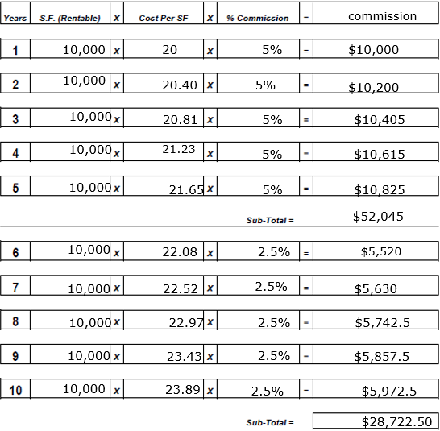
Commissions
15 Year Initial, S.F.=10,000, base rent 20 NNN, 2% increase per year

Slide 18
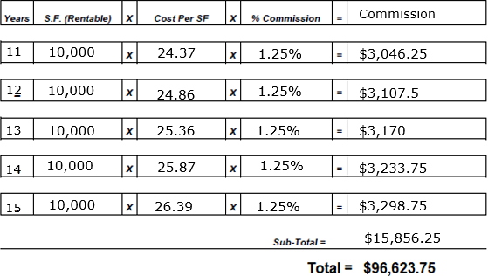
Commissions
15 Year Initial

Slide 19
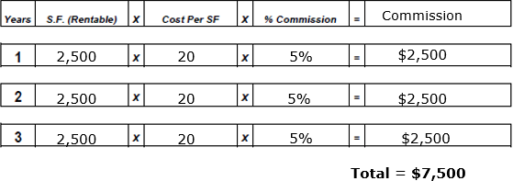
Commission Calculation Form
3 Year Initial
s.f. = 2,500 rentable s.f.
Base rent = 20 gross fixed for year 1-3

Slide 20
V. Determine Value of Commercial Property
Value can be determined by comparative analysis or income approach.
V = R
I
R = Rent or Revenue from property often called NOI – net operating income
base rent x rentable s.f. x .9 (Vacancy Factor and Capital Reserve)
I = Interest rate or capitalization rate – rate of return for investors. CAP rates vary by the quality of the tenant, the type of business, it’s location and its credit worthiness.

Slide 21
V. Determine Value of Commercial Property
Example:
10,000 s.f. building
2 tenants:
18 NNN in 6,000 s.f.
19 NNN in 4,000 s.f.
cap rate = 7.75%, 6.0%, 9.0%
V= $108,000 + $76,000 x .9 = 184,000 x .9 = $2,136,774
(.0775) (.0775)
V= $108,000 + $76,000 x .9 = 184,000 x .9 = $2,773,500
(.06) (.06)
V= $108,000 + $76,000 x .9 = 184,000 x .9 = $1,840,000
(.9) (.9)
21

Slide 22
V. Determine Value of Commercial Property
Summary:
Cap Rate
Cap Rate Cap Rate
9% = $1,840,000
7.75% =$2,136,774
6% = $2,773,500

Slide 23
Commercial Forms On Our Intranet
Documents
Commercial Letterhead
LOI Lease Proposal - Sample 1
LOI Lease Proposal - Sample 2
LOI For Sale Proposal
Exclusive Sale Listing Agreement
Exclusive Lease Listing Agreement
​
Connecticut Association of Realtors
Notice of Commission Rights
Open Right to Sell/Lease/Exchange Agreement
Exclusive Agency Right to Sell/Lease/Exchange Agreement
Exclusive Right to Sell/Lease/Exchange Agreement
​
Greater Hartford Association of Realtors
Letter of Intent to Purchase and Sell
Letter of Intent to Lease
Exclusive Right to Represent Buyer/Tenant
Purchase Contract

Slide 24
Lease Proposal Letter of Intent
Date:
February 26, 2008
SAMPLE
Property:
XXXXXXXXXXXXXXXXXXXXXX
Premises:
Unit C5 1st Floor –rentable 1188 s.f. (per as built)
Use:
Delicatessen
Tenant:
XXXX XXXXX
Landlord:
Parkway Plaza, LLC
Initial Term:
5-year term
Lease Rate:
Year 1 $21.50 Year 2 $22.50 Year 3 $23.18 Year 4 $23.88 Year 5 $24.59
(1) One 5-year option Lease rate starts at a 3% increase from previous term.
Options:
Additional Rent:
Approx. $4.75 p.s.f. common area maintenance.
Landlord Responsibilities for Build Out:
Dropped ceiling and lighting, painting the wall (primer plus 1 coat), installing bathroom; excludes floor covering and partitions.
*Occupancy:
TBD – NLT 1 June 2008
Signage:
As per town signage requirements and consistent with the rest of project signage plan.
Security Deposit:
1st month, last month, and (1) one-month security (3 months)
Parking:
Shared parking
Exclusivity:
X Deli shall be the only Deli in the complex.
Personal Guarantee: Mrs. X shall sign a personal guarantee for the lease.
Brokerage: , RE/MAX Right Choice is recognized as listing broker and procuring broker involved in this transaction and is entitled to all due and appropriate commissions upon tenant occupancy of designated space.
Signature of the parties shall indicate acceptance of the above terms.
Tenant | Date |  | Landlord | Date
Subtenant | Date |  | Listing Broker/Procuring Broker | Date

Slide 25
Lease Proposal/Letter of Intent
Date:
Property:
Premises:
Use:
Tenant:
Landlord:
Initial Term:
Lease Rate:
Fit-Out Allowance:
Options:
Additional Rent:
Occupancy:
Build-Out Signage:
Parking:
Brokerage: , RE/MAX Right Choice, is recognized as sole procuring and listing broker involved in this transaction and is entitled to all due and appropriate commissions upon tenant occupancy of designated space. Signature of the parties shall indicate acceptance of the above business terms. This document is non-binding and shall be superseded by the lease agreement executed by both parties.
Tenant | Date |  | Landlord | Date
Subtenant | Date |  | Listing Broker/Procuring Broker | Date
24

Slide 26
Letter of Intent – Lease Proposal
Date:
XXXXX XXXXX
Senior Vice President
The Commercial Real Estate Group 12345 Main Street
Trumbull, CT 06611
RE: 12345 Main Street, Trumbull, CT 06611
Dear XXXXXX,
On behalf of my client , principal owner, I am pleased to present to you for your client’s review and consideration this Letter of Intent to lease space in the above referenced building under the terms and conditions listed below. This is a non-binding proposal, fully contingent upon gaining the required zoning approvals, and with the execution of a mutually satisfactory lease between both parties.
Building: Landlord: Tenant: Intended Use: Area:
Lease Term:
Lease Commencement: Rent Commencement: Rent:
12345 Main Street, Trumbull, CT 06611
1,512 gross square feet on the first floor; 1724 sf rentable Ten years with two (2) five (5) year renewal options December 1, 2018
February 1, 2019
Years 1-2 32.00 gross
Years 3-4 34.00 gross
Years 5-6 36.00 gross
Years 7-8 38.00 gross
Years 9-10 38.50 gross
Tenants will have full access to the building 24/7/365
Building Access:
25

Slide 27
Letter of Intent – Lease Proposal (Cont’d.)
Parking:
Tenant shall share parking spots at the front of the building. Building currently has spaces or ratio of /1000.
Landlord Work:
Tenant shall be given a TI Allowance of $30,000. Scope of work and contractor must be approved by the owner. Approval shall not be unreasonably withheld.
Right of First Refusal: Tenant shall have the right of first refusal to lease any adjoining space now and in the future should it be available.
Option to Terminate: Tenant shall have a one-time option to terminate the lease after year five. This option should be exercised no later than nine months prior to the end of year five. Should the tenant exercise this option to terminate the tenant agrees to pay a one-time termination fee not to exceed the sum of $26,313.75, which includes ½ of the TI Allowance and ½ of the commission payment.
Security Deposit: First month’s rent and last month’s rent.
Brokerage:
Both Landlord and Tenant agree that there are no other brokers involved in this transaction other than The Commercial Real Estate Group of Trumbull, CT and
of RE/MAX Right Choice. The Listing Broker and Selling Broker will split the commission of 5% for the first 5 years and 2.5% for the second 5 years.
ACCEPTED AND AGREED:
Tenant:
Date:
Owner: Date:
The submission of this LOI is for negotiation purposes and constitutes an offer to lease. This only becomes effective and binding upon the execution and delivery of a lease contract, signed by both parties. That lease contract will supercede this LOI and any and all changes
made to this LOI.
26

Slide 28
Letter of Intent – For Sale Proposal
Dear ,
Re:
I have been authorized to present the following Letter of Intent to purchase the above referenced property. This letter outlines the terms under which Buyer will work toward executing a Purchase and Sale Agreement with Seller.
Both parties agree to use good faith efforts to expeditiously execute a Purchase and Sale Agreement by March 1, 2017. If a Purchase and Sale Agreement is not executed by March 1, 2017 this proposal and all negotiations may be terminated by either party by notice to the other. The Purchase and Sale Agreement will, among other things, contain the following terms and conditions:
1. BUYER:
and or his/her assigns
2. PURCHASE PRICE:
The total Purchase Price for the Property will be two million four hundred thousand
(2,400,000) US Dollars
GOOD FAITH DEPOSIT:
At the execution of the Purchase Agreement by both parties, Buyer will deposit with the Escrow Holder the sum of fifty thousand Dollars ($50,000) as a good faith deposit.
The Buyer's liability will be limited to loss of Deposit, but the Deposit will be refunded if the Contract is terminated,
during the "due diligence period"; (b) because of defect in the Seller's title; or (c) because of the occurrence of an adverse event (such as casualty, condemnation, or a discharge of hazardous substances on, onto or from the Property) before closing.

Slide 29
Letter of Intent – For Sale Proposal (Cont’d.)
DUE DILIGENCE:
Buyer's due diligence will end 21 business days after contract signing and receipt of all the agreed upon due diligence documents. Buyer shall have the right to terminate the Purchase Agreement within this due diligence period for any reason whatsoever. If Buyer terminates the Purchase Agreement within the due diligence period, the deposit shall be returned to the Buyer.
The Contract will contain representations by the Seller, which representations will be true as of closing and will survive closing, as to (a) the Seller having no reports regarding environmental or structural conditions at the Property that were not delivered by the Seller as part of its due diligence materials;
(b) the Seller having received no notices of violation of planning, zoning, environmental or building
laws that remain uncured as of closing; (c) the Seller being unaware of pending litigation that could affect the Seller's contract obligations or the Property; (d) the Seller being unaware of any storage or discharge on, onto or from the Property of hazardous materials, solid waste or petroleum products, except as disclosed in the Seller's due diligence materials; (e) the Seller being unaware of underground storage tanks at the Property, except as disclosed in the Seller's due diligence materials; and (f) the absence of tenants or persons having rights of possession in the Property except as permitted by the Contract.
MORTGAGE INFORMATION:
A) Mortgage: $1,800,000
Term: 25 years
Commitment Date: 45 days from contract execution (Simultaneous with Due Diligence)
Appraisal Contingency: 28 days from the issuance of a loan commitment

Slide 30
Letter of Intent – For Sale Proposal (Cont’d.)
BALANCE OF PURCHASE PRICE:
The balance of the Purchase Price will be paid to Seller in cash at closing.
INSPECTIONS:
During the 21-day due diligence period, the Purchaser shall have an opportunity to conduct or cause to be conducted whatever tests or inspections of the Property it wishes, all at the buyer's expense.
CLOSING:
To occur within 15 business days from final mortgage commitment which is triggered by the Lenders acceptance of the appraised value.
SELLER COVENANT:
Without the prior written consent of Buyer (which shall not be unreasonably withheld) after the Purchase Agreement execution, Seller will not, except as required by law: (i) enter into any new lease agreement, extension, expansion, renewal, or any material modification, or any other form of commitment that will bind Buyer other than lease extensions, expansions or renewals that are required pursuant to the existing leases; (ii)enter into any vendor or service agreement not cancelable as of the Closing; or (iii) allow any interest in the Property to be liened, encumbered or transferred.
COSTS AND EXPENSES:
Buyer will pay costs of all due diligence.

Slide 31
Letter of Intent – For Sale Proposal (Cont’d.)
CONFIDENTIALITY:
Buyer and Seller agree that the terms of this transaction are confidential, and neither will disclose, or permit employees or agents to disclose, the terms of this letter the Purchase Agreement except as reasonably necessary to complete the transaction or as required by law. All Property documents and information are, and shall be treated by Buyer, its agents, employees and consultants as, confidential, and the Purchase Agreement will contain appropriate provisions relating thereto.
BROKER:
is the listing broker in this transaction and is the buyer's broker. Buyer and Seller represent and warrant that neither has employed or dealt with any other broker or finder in connection with this transaction and each party will indemnify the other from and against all brokerage commissions and finders' fees arising or resulting from acts or omissions of the indemnifying party.
This letter is non-binding. It is submitted in the interest of initiating exclusive negotiations with Buyer for the execution of a definitive, binding Purchase Agreement. Nothing contained in this letter is intended to constitute an offer or be binding upon Buyer or Seller.
If the above is acceptable, please execute below.
Sincerely yours,
Broker Name RE/MAX Right Choice
AGREED AND ACCEPTED:
Buyer:
Printed Name:
Date:
Seller:
Printed Name:
Date:

Slide 32
Exclusive Sale Listing Agreement
EXCLUSIVE SALE LISTING AGREEMENT
Date:
I Owner(s) of property at I
authorize RE/MAX Right Choice to act as our broker for a period of months. I (We) hereby grant RE/MAX
Right Choice permission to erect a sign.
If during the term of this agreement RE/MAX Right Choice produces a purchaser ready, willing and able to purchase the property at the price and terms stated herein, or later agreed upon, or if a sale or exchange of the property is made after the term of this agreement to a purchaser procured by RE/MAX Right Choice during the term of this agreement, I (we) agree to pay RE/MAX Right Choice a commission of % of the gross selling price.
Under certain circumstances the Broker may have the right to attach a lien against commercial real property to secure payment of any compensation due the Broker. Those circumstances are set forth in Section 20-325a (c) of the Connecticut General Statutes.
NOTICE: THE AMOUNT OR RATE OF REAL ESTATE COMMISSIONS IS NOT FIXED BY LAW. THEY ARE SET BY EACH BROKER INDIVIDUALLY AND MAY BE NEGOTIABLE BETWEEN THE SELLER AND BROKER. THIS AGREEMENT IS SUBJECT TO THE APPLICABLE PROVISIONS OF PUBLIC ACT 90-246 (THE CONNECTICUT FAIR HOUSING STATUTE).
Sales Price: $
Terms: Inclusions:
Exclusions: Exclusive Listing Begins:
Exclusive Listing Expires:
RE/MAX Right Choice
105 Technology Dr., Trumbull, CT 06611
By:
(Listing Agent)
(Owner)
(Address)
This agreement is subject to Section 46a-64 of the General Statutes as amended. (Public Accommodations Act).

Slide 33
Exclusive Lease Listing Agreement
EXCLUSIVE LEASE LISTING AGREEMENT
Date:
Owner(s) give you, RE/MAX Right Choice, the exclusive right to Lease/Rent real property at . We will refer all inquiries or offers concerning the listed property to you. You may place a "For Lease/Rent" sign on the listed property.
If during the term of this agreement RE/MAX Right Choice produces a Tenant ready, willing and able to lease the property at the price and terms stated herein, or later agreed upon, or if a rental of the property is made after the term of this agreement to a Tenant procured by RE/MAX Right Choice during the term of this agreement, I (we) agree to pay RE/MAX Right Choice a commission as follows:
5.0 % of annual NNN rent 1 through 5 years.
2.5 % of annual NNN rent 6 through 10 years.
1.25 % of annual NNN rent thereafter.
If anyone other than RE/MAX Right Choice leases the space, the schedule is as follows: 7.5% of annual NNN rent, 1 through 5 years.
3.75% of annual NNN rent 6 through 10 years. 1.875% of annual NNN rent, thereafter.
Under certain circumstances the Broker may have the right to attach a lien against commercial real property to secure payment of any compensation due the Broker. Those circumstances are set forth in Section 20-325a (c) of the Connecticut General Statutes.
NOTICE: THE AMOUNT OR RATE OF REAL ESTATE COMMISSIONS IS NOT FIXED BY LAW. THEY ARE SET BY EACH BROKER INDIVIDUALLY AND MAY BE NEGOTIABLE BETWEEN THE OWNER AND BROKER. THIS AGREEMENT IS SUBJECT TO THE APPLICABLE PROVISIONS OF PUBLIC ACT 90-246 (THE CONNECTICUT FAIR HOUSING STATUTE).

Slide 34
Exclusive Lease Listing Agreement
EXCLUSIVE LEASE LISTING AGREEMENT - Continued
Unless otherwise specified, I (we) agree to pay the commission fee for the original lease term, ½ of commission when lease is signed and balance (½ commission) upon occupancy. Commissions on any renewals, enlargements, exercise of options or new leases between Owner and this Tenant shall be paid at that time. Owner agrees to pay agent reasonable legal fees for collection of any commissions that shall become due and payable under the terms and conditions of this agreement.
Leasing Rate: $ NNN or as agreed to Lease Term: Security Deposit:
Owner/Tenant Pays:
Taxes Insurance
Tax Escalation
Exterior Maintenance
Utilities Heat
Interior Maintenance
Cost of Living Inc.
Additional Data: Floor plans and any other pertinent documents related to building should be supplied by the owner.
By signature hereon, Owner(s) acknowledge receipt of a completed copy of this contract.
Exclusive Listing Begins: Exclusive Listing Expires:
(Owner)
RE/MAX Right Choice
105 Technology Dr., Trumbull, CT 06611
By:
(Authorized Representative)
(Address)
This agreement is subject to Section 46a-64 of the General Statutes as amended. (Public Accommodations Act).

Slide 35
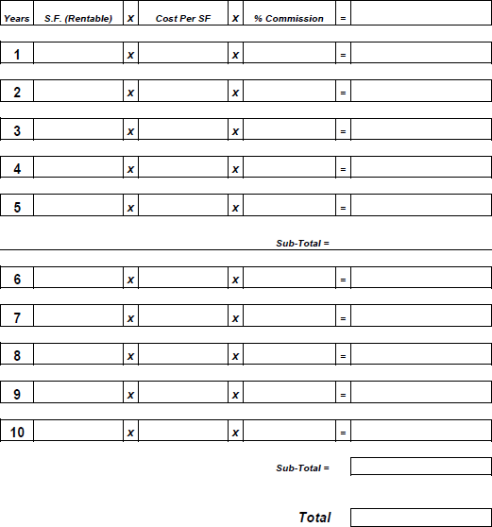
Commission Calculation Form

Slide 36
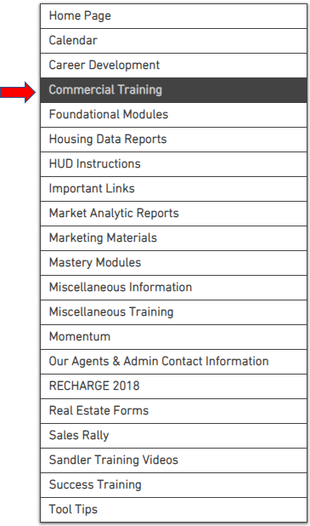
Intranet – www.rmrcagentsite.com
Commercial Training VIDEOS
Commercial Course - January 2018
Commercial Letterhead
Letters of Intent
LOI Lease Proposal - Sample 1 LOI Lease Proposal - Sample 2 LOI For Sale Proposal
Listing Agreements Exclusive Sale Listing Agreement Exclusive Lease Listing Agreement

Slide 37
Concluding Thoughts
You don’t have to be great to start, but you have to start to be great.
Joe Sabah

