Slide 2
The Sandler Selling System
Establishing the Relationship
1) Bonding and Rapport
a) Understand how your customer /client interprets the world
b) Salespeople need to be flexible and change the way they communicate as . buyers or sellers are not going to change how they see the world.
c) The goal is to establish good rapport with your prospects from your very . first meeting
d) People tend to do business with people they like and trust

Slide 3
2) Up-Front Contract
a) The goal is to get mutual agreement
b) A call or meeting that starts well ends well
c) You get to show appreciation and understand how much time you have . . for the meeting
d) You get to figure out what is important to them and what you are trying . to accomplish
e) ANOT

Slide 4
QUALIFYING THE PROSPECT
3) Pain
a) Pain is determining their needs
b) Ideally we are looking for 3 to 5 pains
c) People buy emotionally and justify decisions intellectually
d) Do we have the product or solution to help them
e) People love to buy but hate to be sold
f) You cannot create solutions until you know the full scope of the problem

Slide 5
4) Budget
a) Money, Time, and Resource
b) Find out if the money is available for the sale, and if so, how much is . . . available
c) No mind reading

Slide 6
5) Decision
a) How are decisions made
b) Who makes them
c) When are they made and all the political nuances
d) Your goal is to either: disqualify the prospect, determine that you . need to meet with more people, or qualify the prospect

Slide 7
Closing the Sale
6) Fulfillment
a) Fulfillment is traditionally known as the sales presentation
b) It should focus on the pain you uncovered, meeting the budget . . parameters you identified, and targeting the real decision makers
c) With the traditional model the presentation is upfront
d) With the Sandler selling system we are only presenting at the . . . . end and we are only focused on the pain

Slide 8
7) Post - Sell
a) Counteracting buyers remorse
b) Preventing the loss of the sale to the competition or the . . . . . . . . incumbent
c) Setting an Up-Front Contract about next steps
d) Referrals

Slide 9
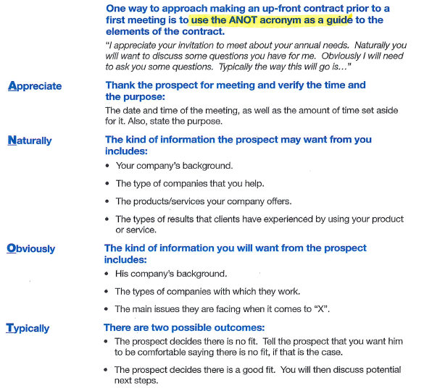

Slide 10
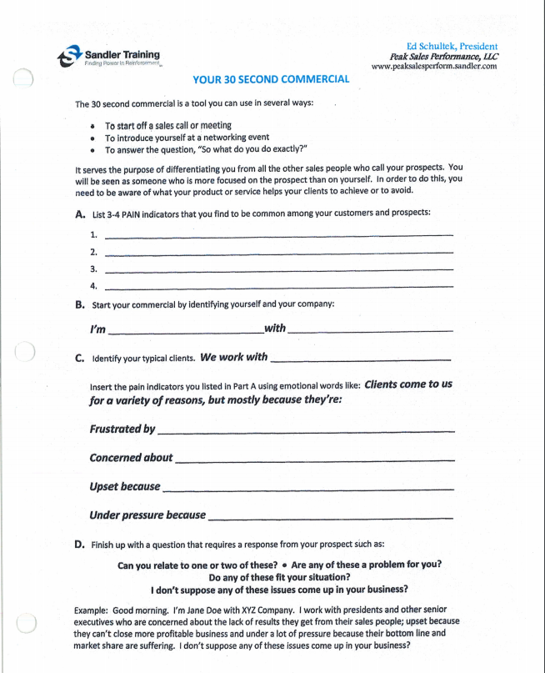

Slide 11
Your 30 second Commercial
39
Clients come to us for a variety of reasons, but most often they come because they are frustrated by the challenging real estate market, they are concerned they may leave hard earned dollars on the table, and they are upset that their previous realtor did not make them a priority.
Clients come to us because they are overwhelmed by the entire sales process and they are terrified they will make a big mistake.
Clients come to us because they are pressured to sell their house because.
Clients come to us because they are concerned about not maximizing the money they receive in a very challenging market.

Slide 12
Your 30 second Commercial
40
Clients come to us because they want someone who will guide them through the negotiation as they are fearful that they will leave money on the table.
Clients come to us because they did not feel that the agents they dealt with previously had the experience to advise them fully, and they were concerned about making a mistake.

Slide 13
PAIN

Slide 14
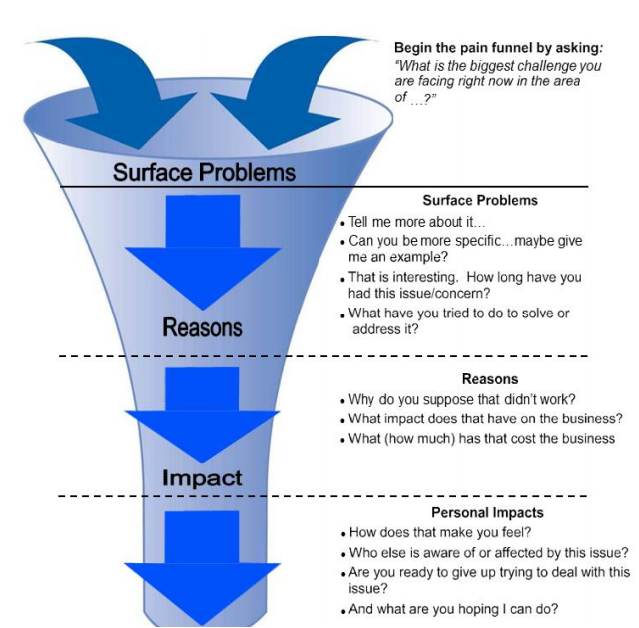
Sandler Pain Funnel

Slide 15
The great majority of sales are done emotionally and justified logically
Pain is very personal and until we determine the pain, the chance of a sale is very limited

Slide 16
Prospects buy or sell for their reasons not for ours
With buyers we have a greater likelihood of success as long as they are qualified and will commit to us
Sellers have more things that need to line up in order to do business with them
No matter whether it’s a buyer or seller most importantly we need to determine their pain - what are their needs

Slide 17
Not every prospect is qualified to be a customer

Slide 18
The prospect has to be in a position to say yes or no

Slide 19
The traditional sales process is Bonding and Rapport, Present and Close
The Sandler system is Bonding and Rapport, Up- Front Contract, Pain, Budget, Decision, Fulfillment, Post-Sell

Slide 20
Only two things motivate people to do things pain or pleasure and pain is four times the motivator
Pain is someone’s compelling emotional reason to do business with you

Slide 21
There are four levels:
Pain in the present is what we should always focus on first
Pain in the future is fear and that motivation is strong but not as strong as pain in the present
Pleasure in the present - a second home, new boat
Pleasure in the future and for this to work you have to have a previous track record and have created trust ((ie You have sold them already a half a dozen flip houses that he or she has profited from))

Slide 22
Prospects pick up the phone or contact through your website based on hope
They are only going to give you money if they believe in you and they’re not going to believe in you if you do not understand their world i.e. their pain

Slide 23
Our goal is to find 2 to 3 pains. Then once we do that you can move into the budget step
The budget step if they are purchasing is based around price. If they’re selling it is based around the commission

Slide 24
Our first goal is to uncover all the reasons why they are considering buying or selling:
There are three elements of pain:
Surface pain
Reasons for the pain
Impact of the pain

Slide 25
Unless you can fully uncover their pain you cannot offer complete solutions to their needs and or problems
You do not want to paint seagulls into the scenario as is it only creates confusion for the prospect
A confused mind often becomes paralyzed and will take no action to sell or buy

Slide 26
We are not unpaid consultants and we need to stop solving their problems until we have a commitment

Slide 27
We have to remember that there are emotional and intellectual reasons for doing something and we have to focus on the emotional and justify with the intellectual

Slide 28
We have to remember that if there is no pain there is no sale and only a big waste of time for us

Slide 29
Pain examples:
We want to live closer to our son or daughter
We want to live closer to our grandchildren so we can see them grow up and play sports
We are having a third child and we need an additional bathroom and bedroom
We want to move to the best school district in the state
I need to move closer to the train station so I can be home for dinner with the family
The house and yard are way too big for me to take care of anymore

Slide 30
If we can determine three pains there is a 50% chance we will be successful, if we can determine five pains there is a 90% chance we can be successful

Slide 31
We need to always summarize, validate/verify what’s important to them, and get commitment
One of the three things typically gets in the way for buyer’s or seller’s: timing, money, or who is involved in the decision-making process
Which do you think applies in your situation ?
In the Sandler selling system we do not want to wait to deal with objections at the end of the sales cycle

Slide 32
The pain step in the Sandler selling system is where we should spend 40 to 50% of our time as it is vitally important. Pain is the compelling emotional reason to do business with you
Pain is the difference between where the prospect is and where the prospect wants to be

Slide 33
Sandler Pain Funnel

