Slide 1

Activities Management
Reaching Your Potential

Slide 2
Reaching Your Potential
Reaching one’s potential really means maximizing one’s output
To maximize one’s output we have to work more effectively and more efficiently
More effectively means doing the right things, the right activities, the right way
More efficiently means to eliminate or cut waste

Slide 3
Reaching Your Potential
How do we do that?
By being intentional and proactive

Slide 4
Reaching Your Potential
What’s the best way to do that?
AMS – Activities management systems
AMS keeps you focused on the right activities and performing them in a way that eliminates waste.

Slide 5
Reaching Your Potential
Reach Potential
Maximize Output
E + E (Effective + Efficient)
I + P (Intentional and Proactive)
AMS (Activities Management System)

Slide 6
Reaching Your Potential
Our main role is to focus on how we think so we can do what we need to do to get what we want. The goal of training is action, and before we can encourage action, before we can affect action, before we can change behavior, we first have to change the way we think about things.

Slide 7
Reaching Your Potential
Let’s get our brain’s thinking
Let’s put things in perspective
Let’s get in the right mindset

Slide 8
Every day in Africa, a gazelle wakes up. It knows it must run faster than the fastest lion or it will be killed.
8

Slide 9
Every morning a lion wakes up. It knows it must outrun the slowest gazelle or it will starve to death.
9

Slide 10
It doesn’t matter whether you are a lion or a gazelle…
10

Slide 11
When the sun comes up, you better be running!
11

Slide 12
Reaching Your Potential
What the lion and the gazelle have in common is that they are both running with a purpose.
It's not just about getting up and running in a reactive manner, it's about getting up and running with a purpose. It's about being proactive, and that takes us right back to being intentional and proactive.

Slide 13
Reaching Your Potential
"God, I'm glad I did that" versus "I wish I had.”
"I wish I had days" lead to "I wish I had weeks." That's what we call weeks of regret, which lead to "I wish I had months”, "I wish I had years." And Heaven forbid, "I wish I had life."
"I'm glad I did" or "I wish I had." We want to challenge you to have I'm glad I did lives.

Slide 14
Reaching Your Potential
Typical behavior reaps typical results!
“People assume everyone wants to reach their potential and be the best they can be. I’ve concluded most only want to be average and do just enough to get by!” – Nick Saban

Slide 15
Reaching Your Potential
He's seen what we are going to define as a lot of wasted potential.
There are three types of people out there. There are people who want to be great, and there are people want to be good and there are people who want to do just enough to get by.

Slide 16
Reaching Your Potential
I want to challenge you to be great.
But you are going to have to get out of your comfort zone if you want to go towards greater success.

Slide 17
Reaching Your Potential
Jim Collins wrote a great book called "Good to Great". And the first line in that book says "Good is the enemy of great.”
What he meant by that is it's difficult to be great when you're already good, because good's good. Good's comfortable. Good's warm. Good's friendly. Good gets me what I need. Good has me securely fixed in my comfort zone.

Slide 18
Reaching Your Potential
"There's something beyond good. Are you willing to go there?
Well for things to go to the next level, something has to change. A change has to occur.
And remember, change is uncomfortable. Change gets us out of our comfort zone.
There's no growth without change
And if change is uncomfortable, then there is no growth without discomfort

Slide 19
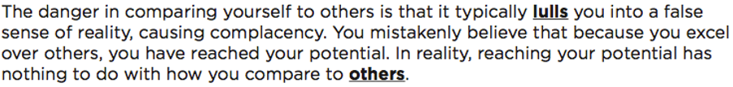
Activities Management
19

Slide 20
Activities Management
20

Slide 21

Let’s Get Clear
21

Slide 22
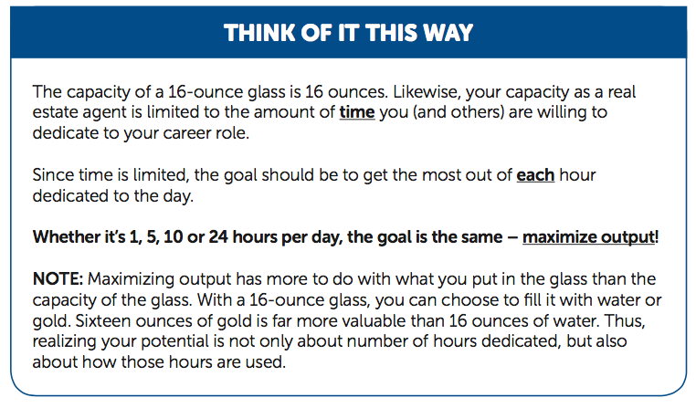
Let’s Get Clear
22

Slide 23
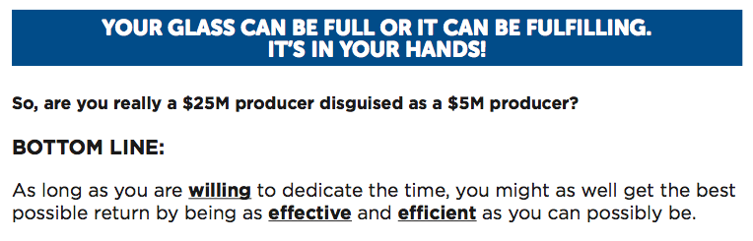
Let’s Get Clear
23

Slide 24
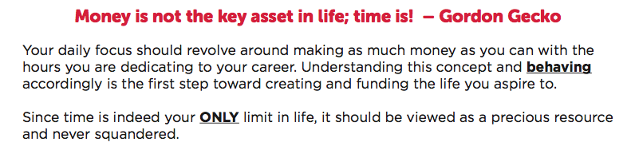
Time Is Your Only Limit
24

Slide 25
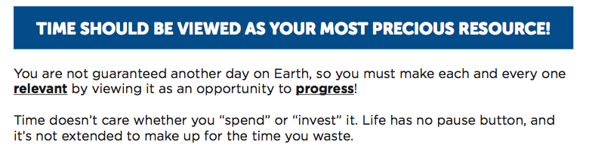
Time Is Your Only Limit
- Are we getting the return we want?
25

Slide 26
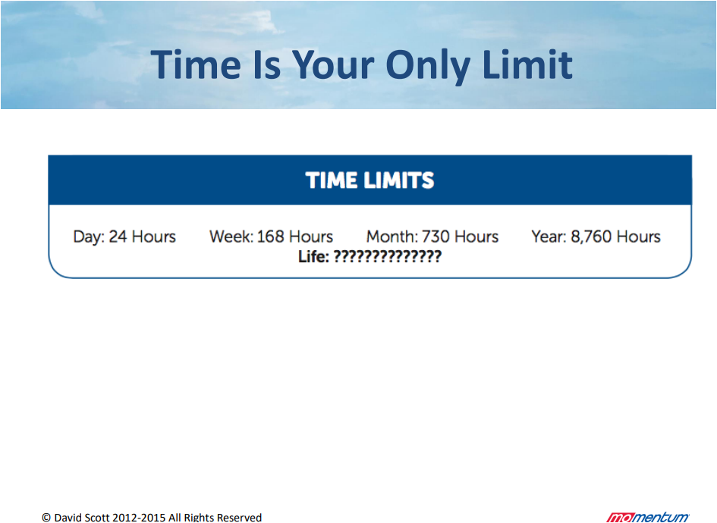

Slide 27
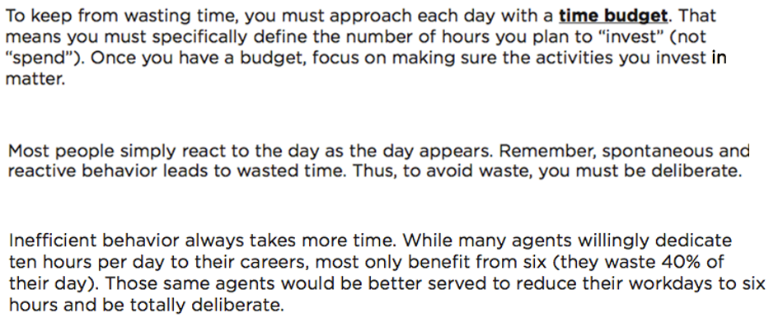
Time Is Your Only Limit
27

Slide 28
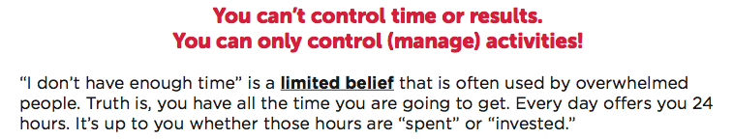
The Cost Of Wasting Time
28

Slide 29

The Cost Of Wasting Time
29

Slide 30

The Cost Of Wasting Time
30

Slide 31
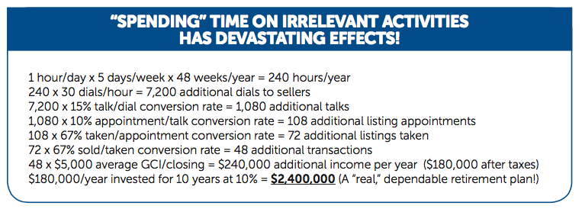
The Cost Of Wasting Time
31

Slide 32

Choosing A Career Path
Your path determines your potential!
Full-time Realtors fall into one of four categories:
Typical Salesperson (remains in Phase 1)
2. Thriving Salesperson (progresses from Phase 1 to Phase 2)
3. Typical Entrepreneur (jumps from Phase 1 to Phase 3,
bypassing Phase 2)
4. Thriving Entrepreneur (progresses from Phase 2 to Phase 3)
32

Slide 33
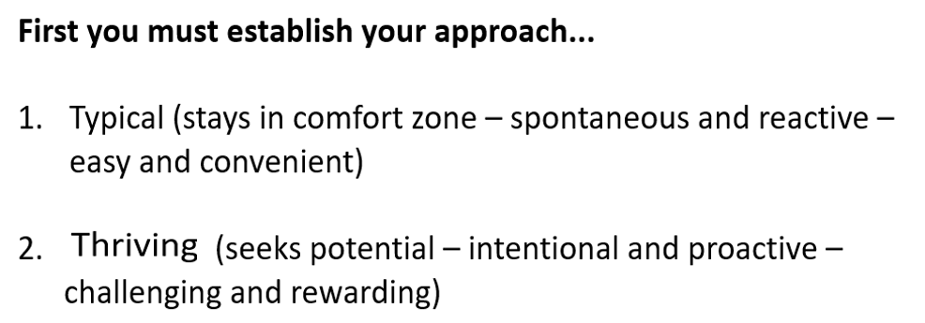
Choosing A Career Path
33

Slide 34

Choosing A Career Path
34

Slide 35
Choosing A Career Path
Truth:
Everyone begins as a Typical Salesperson
35

Slide 36
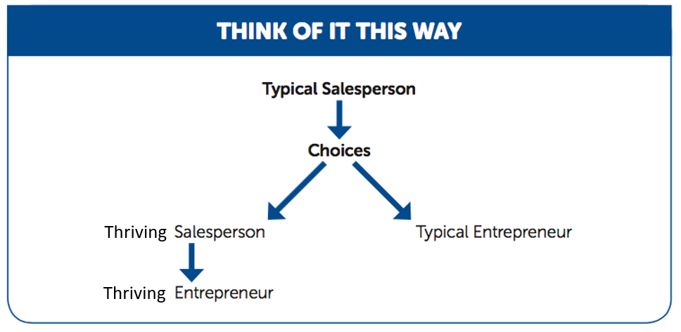

Choosing A Career Path
Thriving
Thriving
36

Slide 37
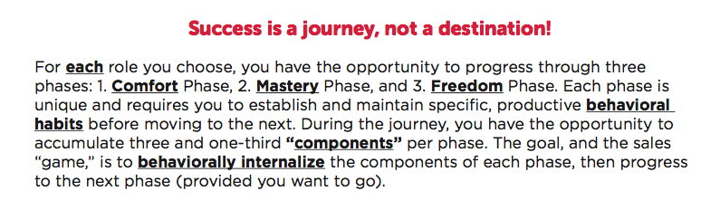
The Journey To Abundance
37

Slide 38
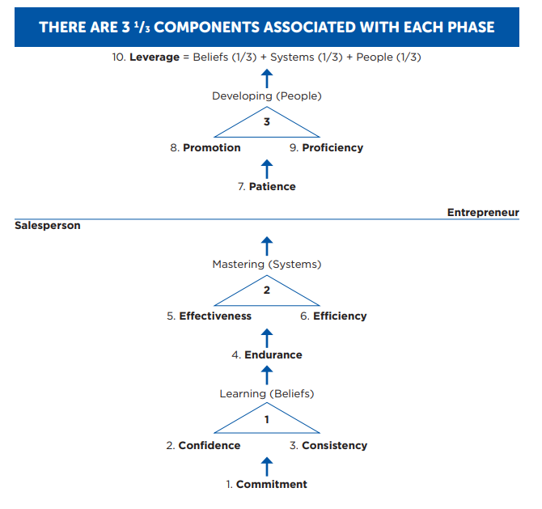
The Journey To Abundance
38

Slide 39
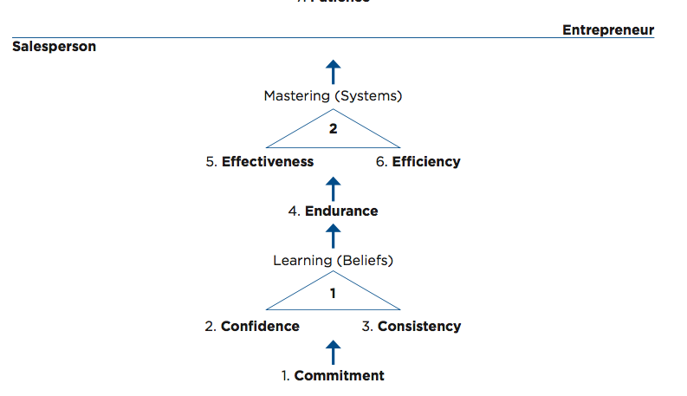
The Journey To Abundance
Phase 1: Typical
Phase one is at the bottom. Phase one revolves around what we call the three C's. There need to be commitment to the role. There needs to be confidence in the role. There needs to be consistency in the role.
Most salespeople, once they reach a level of confidence, once they reach a level of consistency, they choose to stay there. Why? Because that's a comfort zone.
39

Slide 40
The Journey To Abundance
Phase 2: Abundant – Best They Can Be
The next phase, now we move up to the mastery phase. Now we move into, "Okay, are you willing to endure? Are you willing to get outside of your comfort zone? Are you willing to struggle a little bit? Are you willing to get uncomfortable." A lot of people are unwilling to endure.
40

Slide 41
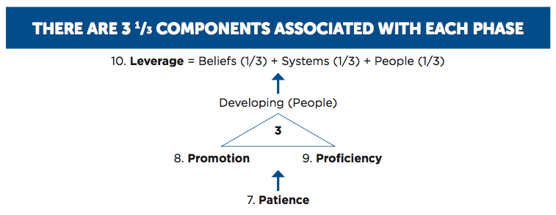
The Journey To Abundance
Phase 3: Team Mastery Developed Others HPT
Phase three, and you see the horizontal line there that says salesperson below the line, entrepreneur above the line. Phase three gets into the entrepreneurial shift. I now want to work on building a business as opposed to simply staying self employed, and so what phase three requires is patience. It requires the willingness and ability to promote or develop others. It requires a team being highly proficient. Proficiency means mastery.
We have what's called an HPT, highly proficient team built.
41

Slide 42
10 Steps To Becoming Fully Leveraged
close and increasing profitability.)
Designed to maximize output
Going from Phase 1 to Phase 2:
Making you the most effective and efficient
Are you doing the right things, the right way – are you involved in the right activities?
42

Slide 43
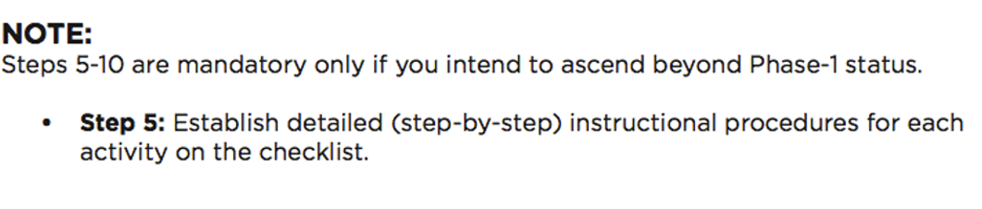
10 Steps To Becoming Fully Leveraged
Going from Phase 2 to Phase 3
43

Slide 44
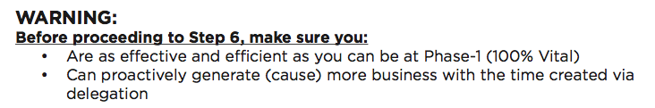
10 Steps To Becoming Fully Leveraged
44

Slide 45
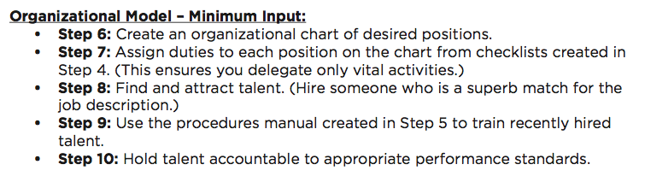
10 Steps To Becoming Fully Leveraged
Agents need to track two things. Money and time
Steps 1-4 are all about maximizing cash flow
Steps 5-10 are all about gaining better life balance
45

Slide 46

The 5 Tools Of Intent
A: Because they intend to.
It is not by luck, it is by design.
46

Slide 47
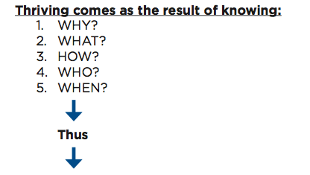
The 5 Tools Of Intent
47

Slide 48
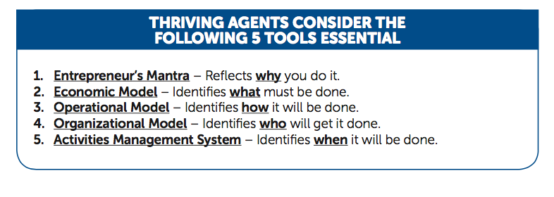
The 5 Tools Of Intent
What are your aspirations.
*
48

Slide 49

Getting In The Right Block
Time management is an oxymoron
49

Slide 50
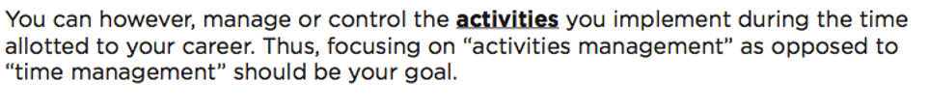
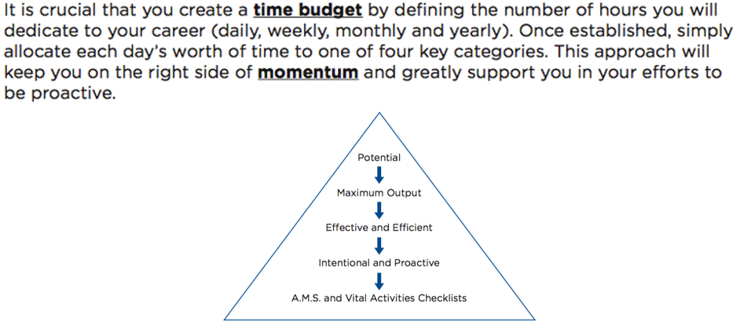
Getting In The Right Block
50

Slide 51
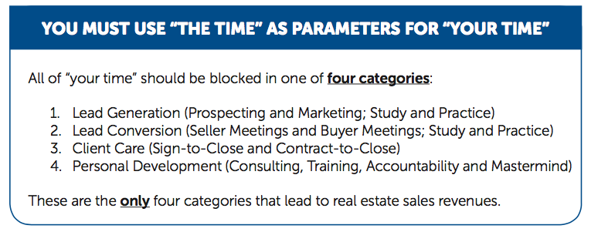
Getting In The Right Block
AMS – Activities Management System
51

Slide 52
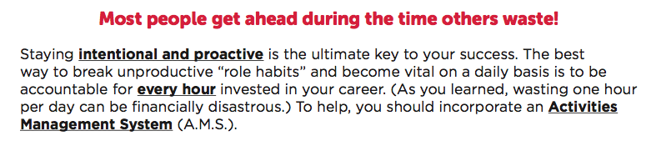
Taking Control Of Your Activities
52

Slide 53
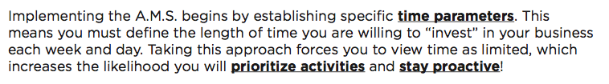
Taking Control Of Your Activities
53

Slide 54
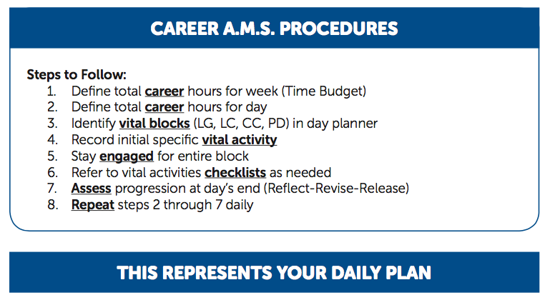
Taking Control Of Your Activities
54

Slide 55
10 Steps to Becoming Fully Leveraged
The 1st one is define the total career hours for the week.
Remember we talked about having a budget for your money, there also needs to be a budget for your time
It's like money. Pretend I gave you $50 to go to the grocery store for the week and that’s all you had. You can't buy $51 worth, and if you buy $48 worth you don't get to keep the change because it doesn't carry over." Your time doesn't carry over to the next week.
You would buy the important things. You wouldn't squander it, if that's all you had to spend and you had to give the rest back. You'd make sure that you spent it all. Same way with time. You have 50 hours to invest not 51, not 49, 50.

Slide 56
10 Steps to Becoming Fully Leveraged
Step 2 is define the career hours for the day so when I wake up on Monday, I know I have 50 hours to invest this week. Okay, how many of those hours am I going to invest today?

Slide 57
10 Steps to Becoming Fully Leveraged
The 3rd one is that I identify my vital blocks. They're four blocks. Right, there's lead generation, lead conversion, client care and personal development for an agent.
The 4th one is to record the initial specific vital activity. There were 47 vital listing activities. 47 vital buyer activities.

Slide 58
10 Steps to Becoming Fully Leveraged
The 4th one is to record the initial specific vital activity. There were 47 vital listing activities. 47 vital buyer activities.

Slide 59
10 Steps to Becoming Fully Leveraged
The 5th one is stay engaged for the entire block. If I have a two hour lead generation block, I want to stay engaged inside of that block. I don't want to call just until I get someone and then end on a high note. I want to make sure that I'm engaged for those two hours.
It keeps me from going from one chore to the next, to the next, to the next constantly having to switch channels. It would be the equivalent of watching TV just constantly switching channels.

Slide 60
10 Steps to Becoming Fully Leveraged
The 6th one is refer to the vital activities checklist as needed. It tells you step by step what you need to do. Those activities are in progressive order.
They help to be consistently dollar productive, and consistently at their highest and best use.

Slide 61
10 Steps to Becoming Fully Leveraged
The 7th one is assess progression at day’s end
(Reflect – Revise – Release)

Slide 62
10 Steps to Becoming Fully Leveraged
Then step 8th is just repeat steps 2 - 7
If I set out with a 50 hour week goal, and I invested 10 hours
I was vital for eight but I wasted two
“I have 42 hours left”

Slide 63
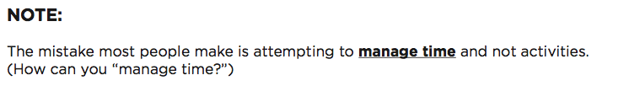
Taking Control Of Your Activities
63

Slide 64
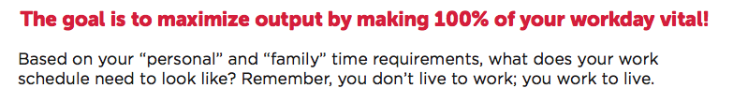
An Intentional & Proactive Example
64

Slide 65
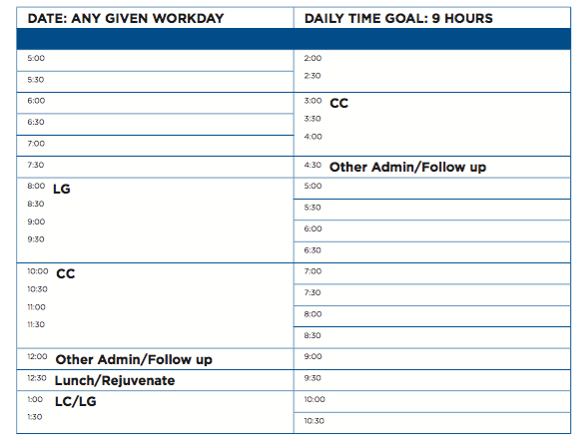
An Intentional & Proactive Example
65

Slide 66
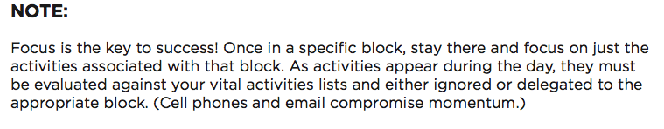
An Intentional & Proactive Example
66

Slide 67
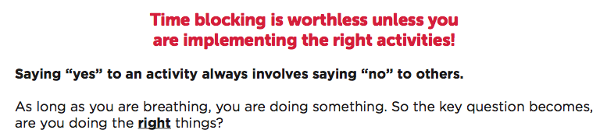
Focusing On The Right Activities
67

Slide 68
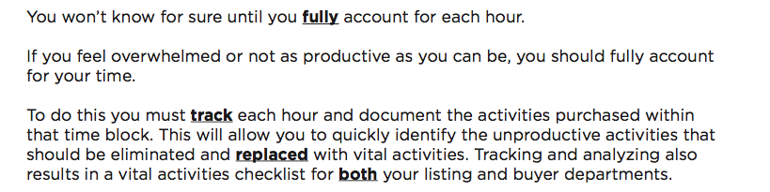
Focusing On The Right Activities
68

Slide 69
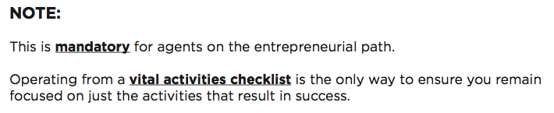
Focusing On The Right Activities
69

Slide 70
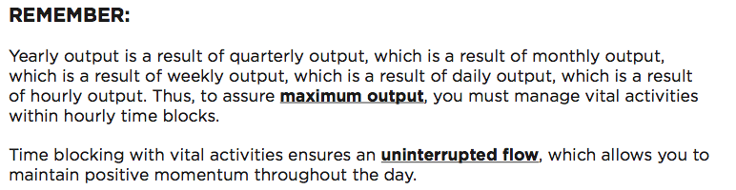
Focusing On The Right Activities
70

Slide 71

Focusing On The Right Activities
71

Slide 72
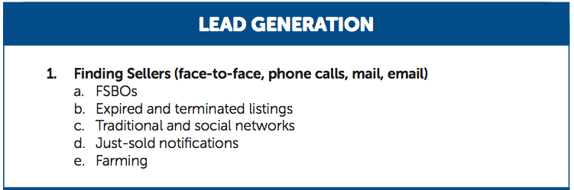
47 Vital Listing Activities
72

Slide 73
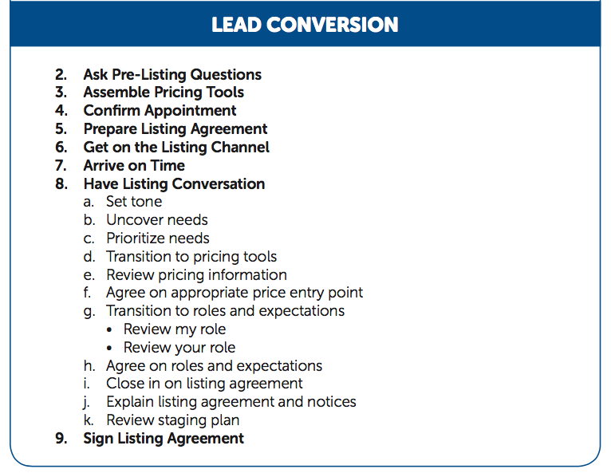
47 Vital Listing Activities
73

Slide 74
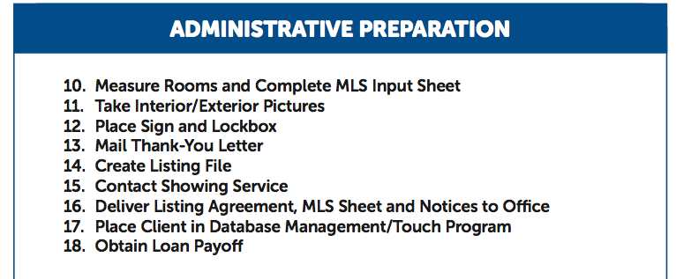
47 Vital Listing Activities
74

Slide 75
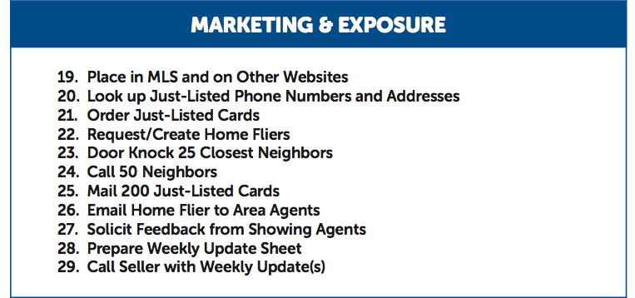
47 Vital Listing Activities
75

Slide 76
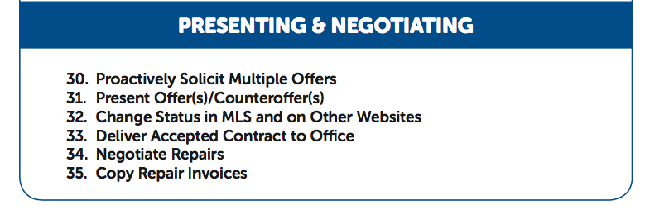
47 Vital Listing Activities
76

Slide 77
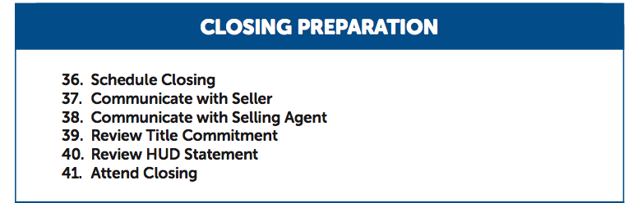
47 Vital Listing Activities
77

Slide 78
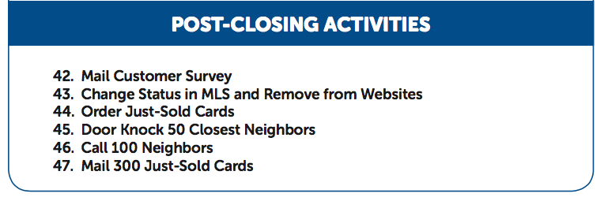
47 Vital Listing Activities
78

Slide 79
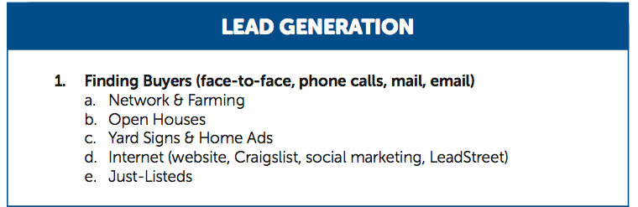
47 Vital Buyer Activities
79

Slide 80
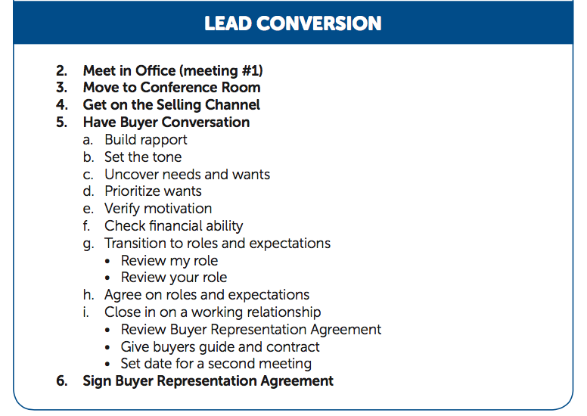
47 Vital Buyer Activities
80

Slide 81
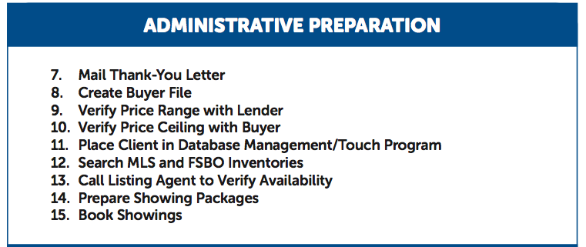
47 Vital Buyer Activities
81

Slide 82
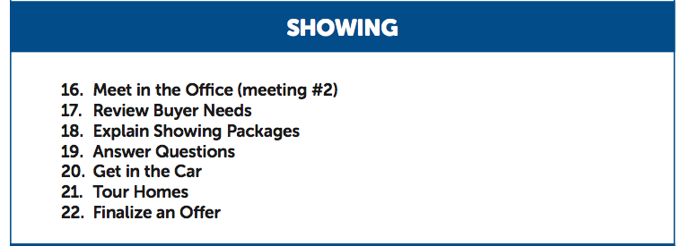
47 Vital Buyer Activities
82

Slide 83
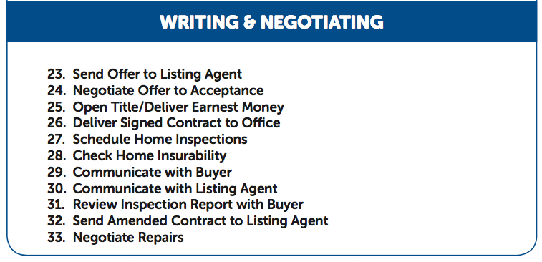
47 Vital Buyer Activities
83

Slide 84
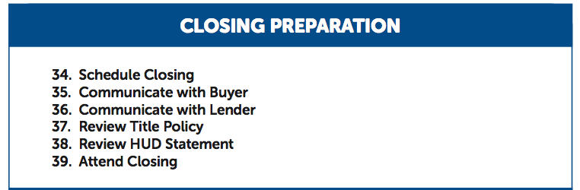
47 Vital Buyer Activities
84

Slide 85
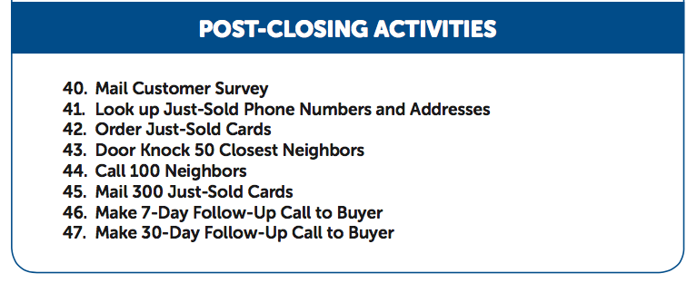
47 Vital Buyer Activities
85

Slide 86
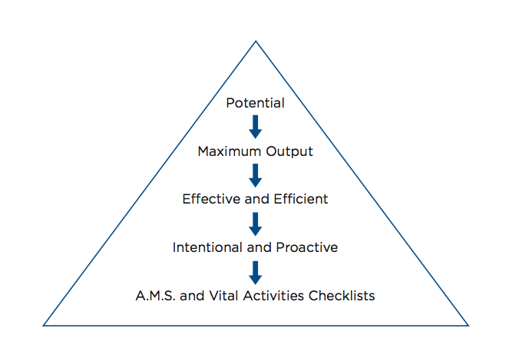
Summary
86

Slide 87


Concluding Thoughts
You don’t have to be great to start,
but you have to start to be great.
Joe Sabah

