Slide 1

Knowing What to Say Earns You More Dollars

Slide 2
Knowing what to say in certain situations helps us to build our confidence, and, in many cases, to WIN Business and close deals. We will explore some listing, selling, and negotiation scenarios.

Slide 3
Learning someone's pain, needs, or what is most important to them is critical.

Slide 4
Uncover Pain, Needs and Wants
Pain is determining needs
People buy emotionally and justify decisions intellectually
You cannot create solutions until you know the full scope of the problem
When uncovering needs, you must know when to ask for further definition and /or clarification.
Anytime, other than when describing price, the seller uses words such as good, regular, competent, knowledgeable, quick, low, high, etc., you should ask for further definition by following up with the question, “What’s your definition of?”

Slide 5
Some Things I Always Try To Say
My goal is to make this a great transaction for you and your family
For me it is win-win relationship, or it does not work
I want you to feel comfortable each step of the way. Please feel free to ask questions at any time
I will never do anything that is not in your best interest. I will always let you know if I think you are making a mistake, or if you're better off responding in a certain way. From there the decision is yours
My goal is to earn your trust now and forever
I always want to know the things that are most important to you in the context of the transaction. This information will help me to make this a great transaction for you

Slide 6
Critical Things We Need To Remember
1. TRUSTED ADVISOR- The seller is deciding in the first 5-7 minutes if they can trust you. All things being equal, people do business with people they trust. All things not being equal, people still do business with people they trust.

Slide 7
Critical Things We Need To Remember
2. I’VE GOT THIS: NO WORRIES- Do they FEEL your Confidence, Non-Verbal actions
Body language comprises 55% of our communication, tone of voice 38%, and words 7%
Above all else, sellers are attracted to professionals they believe can get results
Thus, part of your goal is to demonstrate that you possess the knowledge, skills, and traits needed to get the job done

Slide 8
Critical Things We Need To Remember
3. YOU ARE OK, I’M NOT OK- Do not make them feel more NOT OK
People learn by the time they are five years old (and they hope you never learn) that they are not ok, and they spend 75% of their life covering that up
Everyone is fighting for OK–ness
Reach for the prospect’s Ok–ness
I’m not selling a home or buying a home from you if you make me more not OK

Slide 9
Critical Things We Need To Remember
4. VALUE PROPOSITION- What is your elevator speech? It needs to be tied to pain, emotional words, and thoughts
Most people hire me for one of three reasons:
  One, they are concerned about getting full market value for their home and not leaving money on the table
  Two, they have a fear their house may not sell in the timeframe they would like
  Three, they were upset that the last Realtor they hired did not make them feel like they were a priority

Slide 10
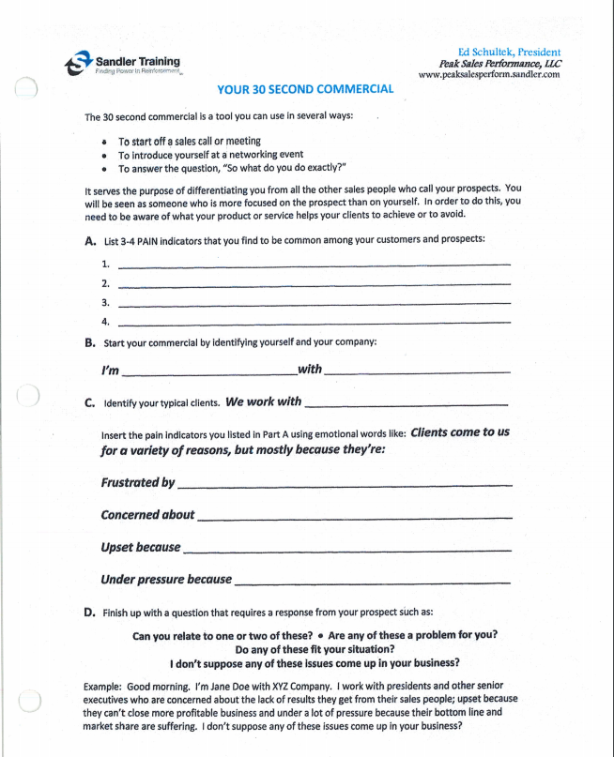
30 Second Commercial

Slide 11
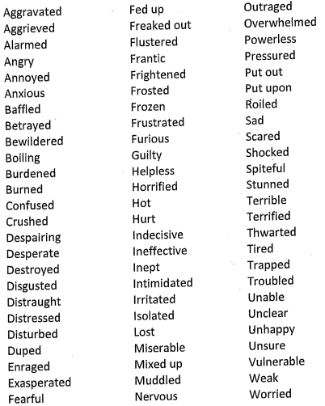
Pain Words
Words to use when talking to a prospect to uncover their emotional pain.

Slide 12
30 Second Commercial
Clients come to us for a variety of reasons, but most often they come because:
They are frustrated by the challenging real estate market
They are concerned they may leave hard earned dollars on the table
They are overwhelmed by the entire real estate sales process
They are upset that their previous Realtor did not make them a priority
They are afraid / terrified they will make a big mistake
They are worried that not all Realtors understand how to sell a high-end home or a vintage home
They are concerned about not maximizing the money they receive in a very challenging market
They are pressured to sell quickly, and they want someone who understands what needs to be done so they do not get trapped
First- time home buyers come to us because they are overwhelmed by the entire home buying process
They doubt they will find someone they can trust

Slide 13
Critical Things We Need to Remember
5. MARKET KNOWLEDGE- Do you know the price entry point to have the greatest chance of selling their home
6. OBJECTION HANDLING, QUESTIONS AND CONCERNS- In order to win listings you need to be able to master objection handling with knowledge and confidence
Objections disappear in direct proportion to a seller's confidence in you and your abilities

Slide 14
Critical Things We Need to Remember
7. CONVERSATIONAL APPROACH- Goals of a conversational approach:
To help clients make informed, intelligent listing decisions
To see if a win–win working relationship can be created
Complete self-discovery by sellers

Slide 15
Critical Things We Need to Remember
8. THE LISTING CONVERSATION
Not all Realtors are the same
We must find and agree on the most appropriate price entry point
We each have rules with specific expectations
Telling sellers you are different and can add more value isn’t enough. You must allow them to self discover what a working relationship with you will be like. It’s all the way we handle ourselves, how we speak, how we make them feel

Slide 16
Critical Things We Need to Remember
9. PRESENTATION
The best presentation you will ever give, the prospect will never see
10. LISTEN AND SPEAK
Listen 70% of the time and speak 30% of the time or less
11. WIN – WIN
Do they FEEL you are aligned

Slide 17
Establishing the Relationship
Bonding and Rapport
Understand how your customer/client interprets the world
Salespeople need to be flexible and change the way they communicate as buyers or sellers are not going to change how they see the world
The goal is to establish good rapport with prospects from your very first meeting
People tend to do business with people they like and trust

Slide 18
The Purpose of our Meeting
To make sure we can establish a win-win relationship

Slide 19
Confidentiality
I want you to rest assured that anything said here will remain totally confidential. So, please feel free to be as open and honest with me as you feel you can be

Slide 20
My Focus
Understand your specific needs and wants in order to create a success plan that has the greatest chance of achieving your home sales goal. No two homes are the same, and market conditions change very quickly. Our objective is to customize our marketing to your specific situation and needs.

Slide 21
What I Know
It’s unacceptable to leave your money on the table
Homes sell for two reasons: Price and Exposure
The pricing game is all about justification...Buyer’s, Buyer’s Agent’s, Appraiser’s
Pricing is neighborhood/area specific
Pricing and Value can change instantly based on daily market activity- closed sales, new competition, etc.

Slide 22
My Role
My Three Vital Listing Agent Responsibilities
Marketing and Exposure
Lead Generation- Finding the buyer
Lead Conversion- Closing the buyer

Slide 23
Up Front Contract
I appreciate the opportunity to speak with you about selling your home - we will need about 45 minutes, does that work for you ?
Great.
Naturally, as we go through this meeting, you are going to have some questions for me. Please feel free to ask me anything you like, and I will do my best to answer.
And, obviously, I will have some questions for you, is that ok?
Great.
Typically, when we are finished with our meeting one of two things will happen: Either you will be comfortable with what we have discussed and we can talk about the next steps to get paperwork done and the process started or you may not be comfortable to move forward and that is ok as I am not a fit for everyone.
Does that sound fair?

Slide 24
Up Front Contract
Mr. and Mrs. Seller thank you for having me over to talk about your house. I appreciate you thinking about me and RE/MAX Right Choice to help you sell your home.
I wanted to check with you to see if you still have 30-45 minutes for our meeting today.
Yes we do.
Great.

Slide 25
Up Front Contract
I know you are going to have some questions for me and that’s great. I will do my best to answer them.
If it is ok with you, I have some questions for you as well.
Great.

Slide 26
Up Front Contract
When we are through today you will know if we are a good fit. If we are, we will figure out what the next steps are. If we are not a good fit that is ok. We are not a great fit for everyone, and we will not push it.
Fair.
Great.

Slide 27
When Reversed, a Prospect Will Always Redefine His Question
A prospect asks, “When can you have that completed?” You can reverse that question by asking, “When do you need it?”
By answering the question with a question, you reverse your answer until you have the intent and importance of the question.
The prospect might say, “Well, I was hoping to have it by Friday. Can you do that?”
Now you have more information, but you are still not there, yet. You might reverse a second time, and ask, “What’s happening on Friday?” You will usually get an intellectual reason for the deadline like, “We have a relocation offer coming in on Monday, and we need your solution for them.”
In which case, you could reverse a third time to get to the real emotional, pain-filled reason behind the question. You could say something like, “Hmm, I see. How big of a deal is it if you don’t have it on Monday?” The prospect will probably answer, “Not a big deal,” or “That is a huge deal!” In which case, you can now qualify or disqualify the prospect based on whether you can deliver.

Slide 28
Reversing Strategies
A) Good question. Why did you bring that up just now?
B) That’s an interesting question, and the reason you asked is?
C) That makes sense. Why is that important?
D) A lot of people ask that. Can you tell me why you asked that just now?
E) I am glad you asked. What if I said I can deliver what you asked?
F) I understand, if you were me, what would you do?
G) That sounds important to you, if we could provide that, what would be the next step?
H) That’s an excellent question. I really want to make sure that I understand what’s important to you. Please give me a specific example of what that looks like.

Slide 29
Reversing Strategies (Continued)
I ) Why do you ask?
J) Why is that important?
K) What are you hoping I’ll tell you?
L) Why did you bring that up just now?
M) What are you really asking?
N) Did you mean?
O) Help me.
P) I’m confused.
Q) Let me see if I have this straight.
R) What?
S) Oh?

Slide 30
Reversing Strategies (Continued)
Prospect: I believe that there’s a good chance that we will list our house with you.
Salesperson: I appreciate you telling me that. I’m curious, however. When you say, “good chance,” what does that mean?
Prospect: We’re inclined to list our house this spring.
Salesperson: That’s great. Let me ask you something. When you say “inclined,” what does that mean?
Prospect: We’ll be making our decision very soon.
Salesperson: I appreciate you sharing that information with me. When you say, “very soon,” what exactly does that mean?

Slide 31
Listings

Slide 32
Pre-Listing Phone Conversation
Let’s do this...
A- First of all, I appreciate you thinking of RE/MAX Right Choice to help you find / sell your home
N- Naturally, you’re going to have some questions for me, so let’s get those answered
O- Obviously, I’ll have a few myself...I hope you don’t mind if I ask you a few questions
T- Typically, you’ll know at the end if this seems like a fit...if it is, we’ll figure out what the next step is...if it isn’t, then let’s not push it – we don’t fit everybody...is that fair?
2) So you mentioned you’re moving ( )...I never asked why...I’m sure there’s an exciting reason! (HUG)
3) How soon do you have to be there? (HUG)

Slide 33
Pre-Listing Phone Conversation
4) As you can imagine I study real estate sell and buy prices all day long ☺... I’m sure you have a range in mind of what you think your home would sell for. Let’s talk through that bracket and I’ll share with you what other homes, like yours, have sold for in the past few months. How quickly do you have to move? (listen for PAIN)
Sandler Pain Funnel:
...Tell me more about that...
...Have you been thinking of selling for a long time?
...What did you try to DO about it?
...Did that work?
...What do you think that cost you?
...How do you feel about that?
...Finally ready to do something about it?

Slide 34
Pre-Listing Phone Conversation
5) What happens if it takes longer to sell your property than you were anticipating? And then what would happen (refer back to Pain Funnel questions)?
6) You must be very proud of your home. Is there anything left to pay on your property? (HUG)
7) When you or your family have made a decision like this in the past, how have you gone about it? Is there anyone else in your family who will be impacted by selling your home?
8) If there were one or two things you could do to improve the value of your home and the probability of selling it, what would those be? Would you be willing to do those if need be?

Slide 35
Pre-Listing Phone Conversation
9) I’ll be sending some information to you to read prior to my arrival which should help our conversation. Do you think you can read it before I arrive?
10) I’m sure there are some things you’d like to ask before I get there. What would you like to ask me so you can be as comfortable as possible during our discussion?

Slide 36
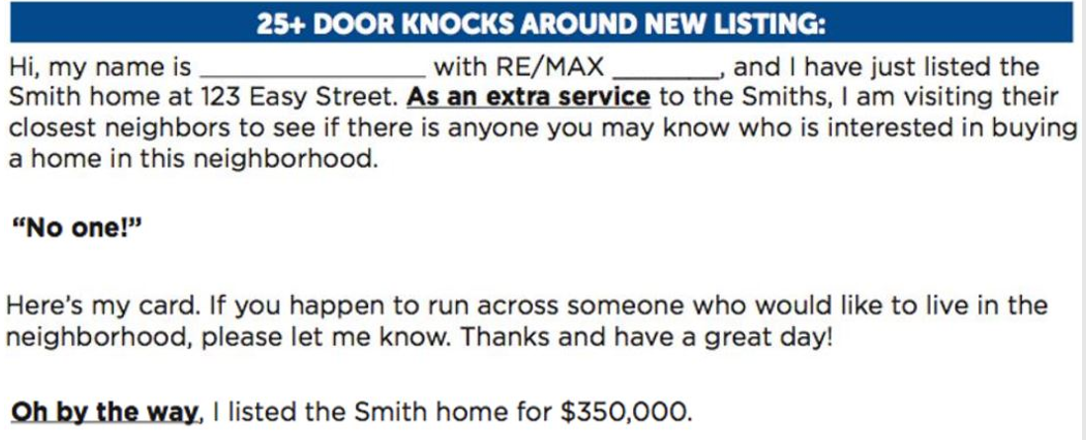
Just Listed Dialogue

Slide 37
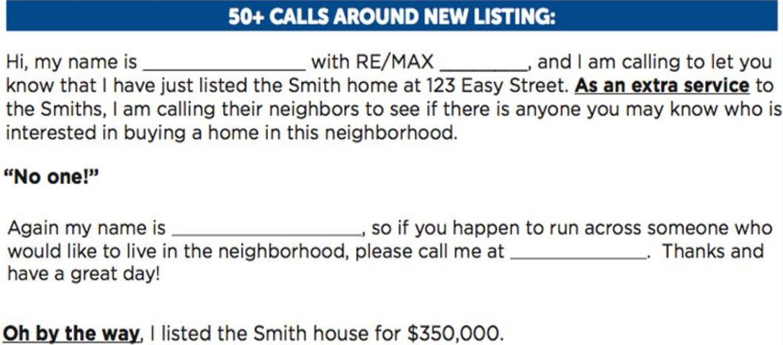
Just Listed Dialogue

Slide 38
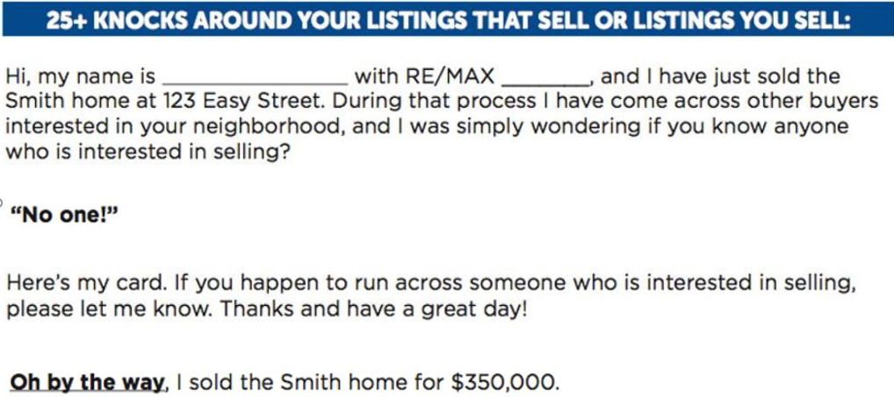
Just Sold Dialogue

Slide 39
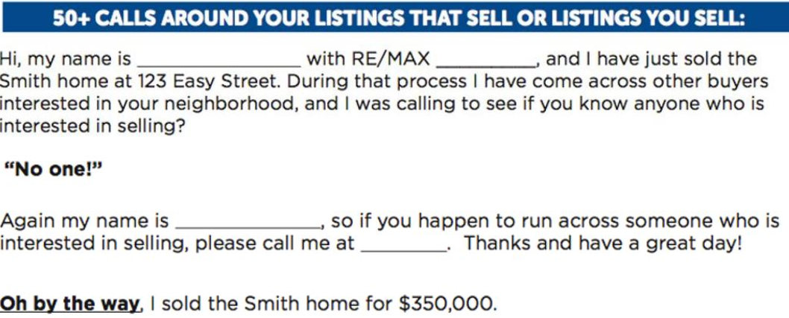
Just Sold Dialogue

Slide 40
Sign & Advertising Calls
“Mr. & Mrs. Seller as you may or may not be aware, RE/MAX works very differently than most real estate firms in that once I list your property, all of the sign and advertising calls go only to me. The RE/MAX philosophy, which is different than most firms, is that we want your inquiries to be handled by the person that knows the most about your property. That person is me.”

Slide 41
Charitable Initiatives
“So, Mr. and Mrs. Seller, I’ve done many presentations for sellers. I constantly refine my presentation because I want to make sure to cover all the important items that make me different than other real estate agents. There are many of us to choose from. One day it occurred to me that the reasons for which a seller would want to work with me are the same reasons that I chose to affiliate with RE/MAX. You see, at one time I too had to choose RE/MAX over all of the other firms out there, just like you’re doing now. Well, one of the big reasons I chose RE/MAX was that their mission is more than just helping buyers and sellers. They are also about helping communities.”

Slide 42
Control of The Listing
“Mr. and Mrs. Seller, I know you told me you are interviewing other agents, and you should. It is a very important decision and all Realtors are not the same.
“At RE/MAX each agent runs his or her business as if they are President of their own company. We prepare business plans, we study marketing strategies, and we control every listing we bring in from contract to close. I work with my seller closely, and, when I commit to something, I always come through. I can do that because I run my real estate business.”

Slide 43
Common Objections
“Price is not high enough”
I totally understand how you feel
Almost every seller I’ve represented felt the same way
We all found it was not up to us – the market dictated
Buyers are the experts on market value in your price range
Strategically a critical decision for both of us (seller and listing agent)

Slide 44
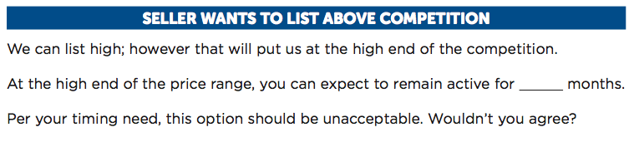
Using the Pricing Tools

Slide 45
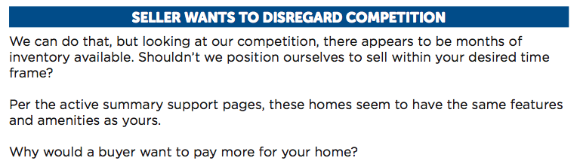
Using the Pricing Tools

Slide 46
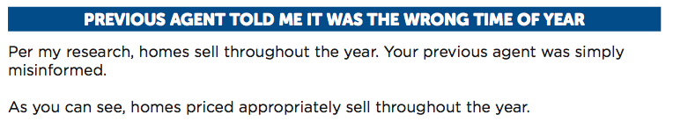
Using the Pricing Tools

Slide 47
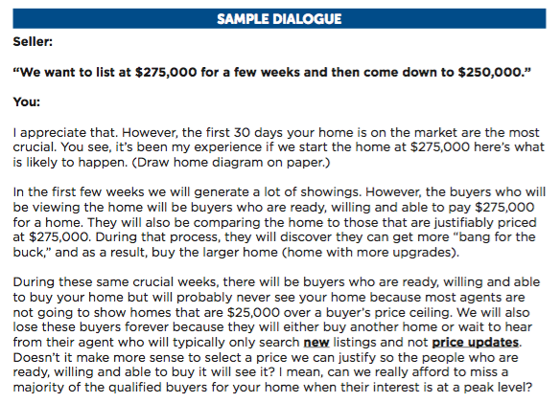
Big House - Small House

Slide 48
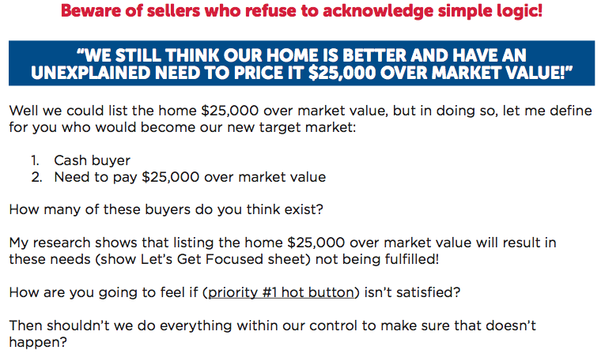
Other Pricing Challenges

Slide 49
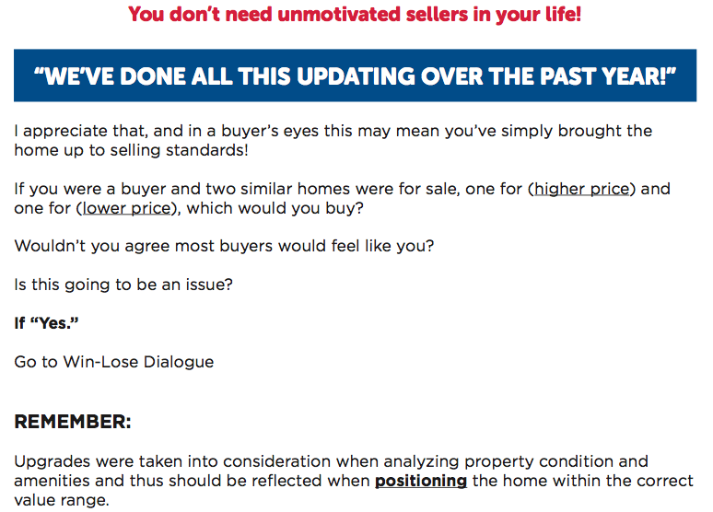
Other Pricing Challenges

